Slide 1
The Civilization of Spring
Warning: a highly speculative talk
By Eugene V. Bobukh

Slide 2
Part 1. The 42 Problem.

Slide 3
Orbital Energy
E = mv²/2, v ≈ 7800 m/s
Large kinetic energy
New York
20 million people, ~5 million cars

Slide 4
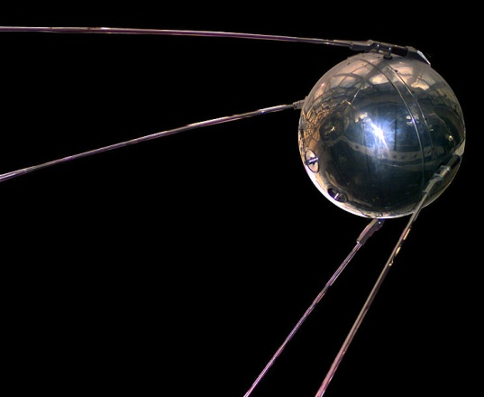
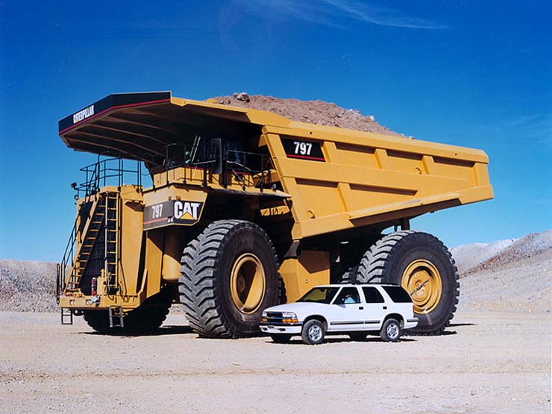
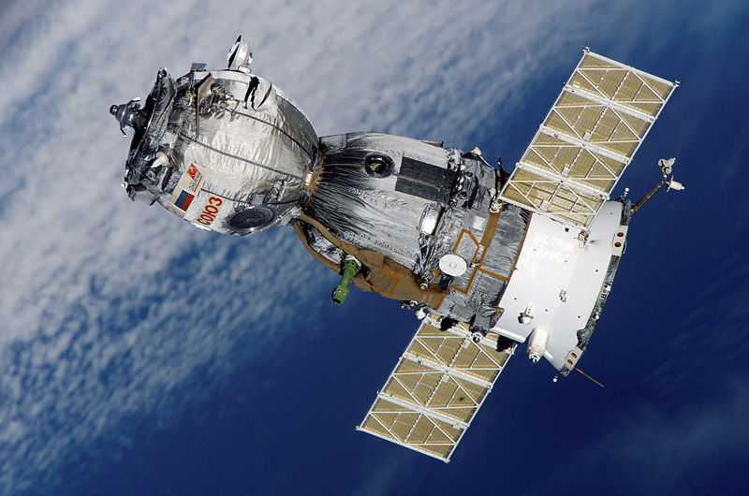
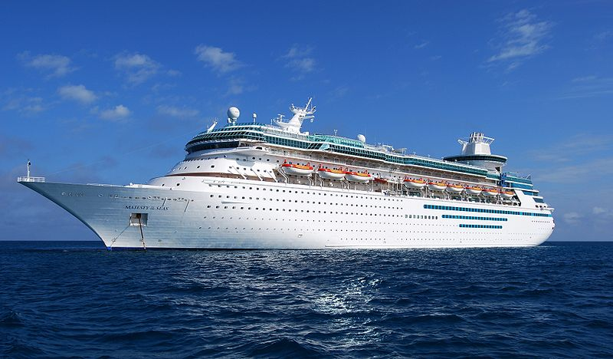
Which of the objects below would have orbital kinetic energy equal to the energy of gasoline burnt by New Yorkers in one day?
Sputnik: 84 kg
Caterpillar 797 loaded: 620 tons
Soyuz TMA spacecraft: 7.2 tons
Majesty of the Seas: 74,000 tons
E = 20e6 people * 3.75 l/gallon * 0.8 kg/l * 4e7 J/kg = 2.4e15 J
m = 2*E/v² = 2*2.4e15 J/(7.8e3 m/s)²= 7.9e7 kg ≈80,000 tones!

Slide 5
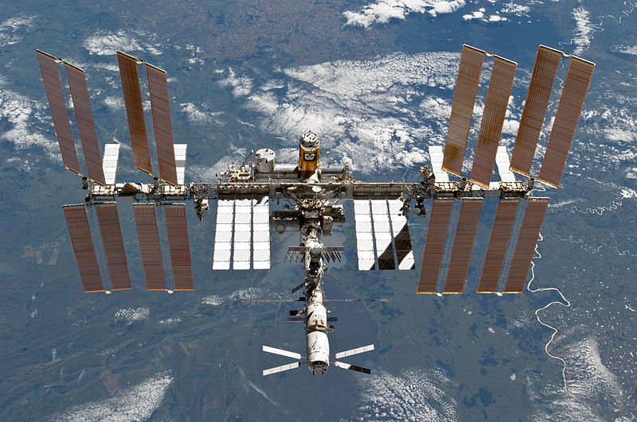
Why does it take then 5 space agencies, 11 years and €100 billion to build 417 tons International Space Station?

Slide 6
The Basics of Rocket Anatomy
}
Payload
E = mv²/2
“Oh Sh*t!”
To carry the fuel, I need energy, too!
more fuel =>
more energy =>
more fuel =>
more energy =>
more fuel =>…
Engines & guts
Energy
Fuel mass
M = E/q

Slide 7
Welcome Saturn V rocket
Humans
Classic multistage design
Start mass: 3040 tons
Payload: 119 tons (3.9%)
Fuel: 2700+ tons.
2300 tons burn in 150 seconds!
Complexity, crazy technology, space materials, hordes of experts => $$$$
And this is one of the most efficient rockets in history. Many do worse in fact.
≈FUEL

Slide 8
So the Problem is…
…not the lack of energy
We have plenty
…but the density of energy packing in its carrier!
Our fuel is too heavy

Slide 9
Can we do any better?

Slide 10
Part 2. Civilization of Spring.

Slide 11
RD-107 engines by Korolev. Designed in 1950s, fly today.
R-7 (1957): launch of Sputnik
Soyuz* (1700+ launches): 2010

Slide 12
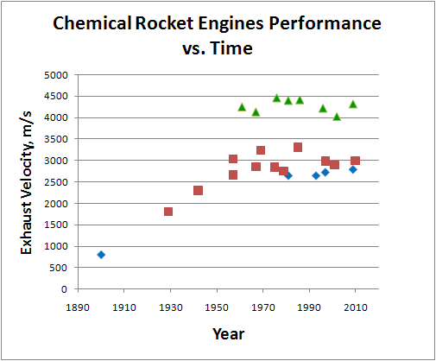
Chemistry: dead end
Engine | Rocket | Year | Fuel | Exhaust velocity, m/s (vacuum) | Notes | T/M ratio
Gunpowder based | Congreve, Hale, all military | 1900 | Gunpowder | 800 | First rockets
Goddard's | Models | 1929 | LOX + gasoline | 1800 | First LOX + gasoline engines
V-2 main | V-2 | 1942 | 75% ethanol + LOX | 2300 |  | 28.9
RD-107 | Vostok, R-7 | 1957 | RP-1/LOX | 3041 |  | 85.7
RL10 | Saturn I, Atlas, Titan | 1961 | LOX/LH2 | 4248 | First LOX/LH2 engine | 36.9
J-2 | Saturn V | 1967 | LOX/LH2 | 4130 |  | 73.2
RD-0120 | Energia | 1976 | LOX/LH2 | 4460 |  | 54
SSME | Space Shuttle | 1981 | LOX/LH2 | 4400 |  | 57.2
LE-5 | H-I (Japan) | 1986 | LOX/LH2 | 4415 |  | 40.4
RS-68 | Delta IV | 2002 | LOX/LH2 | 4022 |  | 51.1
LE-7 | H-II (Japan) | 2009 | LOX/LH2 | 4316 |  | 65.9
Why speed? ‘Cause v ≈ (2ε)^{0.5}
U ≈ (2E/m)^{1/2}
Diamonds: solid rockets (from c. 1100 AC)
Squares: liquid (mostly LOX + kerosene)
Triangles: H₂ + O₂

Slide 13
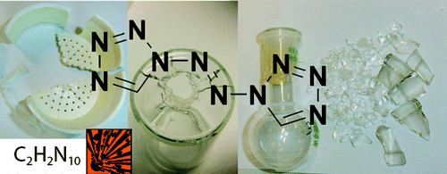
Why is chemistry limited?
http://www.aiaa.org/content.cfm?pageid=406&gTable=mtgpaper&gID=40999, 1968!
E.g., 2H₂ + O₂ = 2H₂O
Energy is stored via regrouping of “outer” electric fields of atoms
Theoretical limit can’t exceed the energy of outer electrons connection to atom ≈ several eV per atom ≈ 10 MJ/kg
The limit reached in 1968: 5320 m/s with Li + H₂ + F₂ but impractical:
Li must be kept over +180 C; ignites on air
F₂ is extremely corrosive; burns almost everything including water; toxic; keep under -180 C
H₂ leaks through metals; 70 kg/m³; explosive; needs -252 C

Slide 14
OK, what else if not chemistry?
Accumulators/batteries?
Based on chemical reactions => same limit
Spring, distorted metal, construction elements?
Energy stored in the distortion of inter-atomic electric fields => same limit
Pressurized gas?
Can’t press it much over the critical density => spring => same limit
Capacitors?
Vacuum capacitors limited by tensile strength of construction => same limit
I can’t reliably prove that in a general case though. Can you?
Dielectric ones: inter-molecular E << outer atomic E => same limit
Hot matter?
Kinetic energy ≈ pressure (not to exceed tensile strength) => same limit
Flywheel?
Limited by the tensile strength of steel => same limit

Slide 15
Our Fundamental Problem
Energy => Ordinary Matter => Electric Fields => Ordinary Matter => Energy
Ordinary Matter is a Middle Man
“Our bank prohibits transactions over 10 eV/atom”
From oil to batteries to crossbow, nearly all our ways to store energy use the same old principle
…And that is…

Slide 16
THE SPRING
Fundamental Limit: 10 MJ/kg

Slide 17
We are a civilization of SPRING
…that’s how we’ve been storing 99% of our energy since 2,000,000 BC…

Slide 18
Alternatives?
Still, can we improve chemistry?
Better middleman?
Cut the middleman?
Change the field used to store energy?
Separate the energy from the carrier?
Abandon jet propulsion altogether?
Change ourselves so travel becomes easier?

Slide 19
Chemistry?
Crazy substances?
E.g., chains of nitrogen (1,1′-azobis(tetrazole), etc.)
Explosive, expensive, not much better
http://www.fas.org/spp/military/docops/usaf/2020/app-i.htm
Detailed research, nothing conceptually new.
Overall, still looks like a dead end

Slide 20
Better middleman?
Inner electrons energy is up to 100s KeV/atom
Pb⁰ -> Pb¹⁰⁺ ionization energy is 360 MJ/kg
K-series X-ray emission (when electrons kicked out from the inner atomic shells return back): 10…100 KeV/atom ~ 10⁹…10¹⁰ J/kg
Some X-ray lasers are proposed to use that
“A tiny, insignificant problem”: how can we actually store energy in that form?
Ionized heavy ions == hot plasma, how to contain?
K-shell vacancies live < ~10⁻¹⁴ seconds

Slide 21
Cut the ordinary matter?
We already started that back in 1700s, by separating electromagnetic field away from the ordinary matter. The first fruits are good:
Electricity over the wire; electric engine; capacitors; electronics; radio; lasers.
Superconducting magnetic accumulators
E = B²/8π (per unit of volume)
Force-free configurations: B parallel to current so p ≈ 0
Store standing waves?

Slide 22
Non-electromagnetic storage? 1/2
Gravitational field
Early use: clepsydra! Very low energy density (~10 J/kg)
Practical battery must be of planetary size to achieve ~10 eV/atom.
Are black holes and neutron stars super-civilizations’ batteries? (>10¹⁴ J/kg!)
Strong interaction
Nuclear and thermonuclear: way to go! Numerous designs are known.
Problem: our bodies use chemistry @ ~10 eV/atom << 1 MeV/atom => contamination over ~1e-5 is dangerous
Who wants flying Chernobyl?

Slide 23
Non-electromagnetic storage? 2/2
Weak force interaction
Beta-decay isotope generators already exist
A bunch of neutrons in a magnetic bottle???
Energy 780 KeV/neutron == 7e13 J/kg, but free neutron half-life is 10 minutes only
Annihilation
Not really field-specific…
…but permits theoretical maximum of mc²/m = 9*10¹⁶ J/kg!
Antimatter storage and production??? Total sci fi today.

Slide 24
Separate energy from the carrier
Laser-propelled “rockets”?
Ice “fuel” evaporated by laser on the ground
Beams of particles?
Energy by wire?
Anti-tank missiles fly 4+ km with wires attached!
For space, ~10¹⁰ watts needed. Unfeasible?
Air-breathing rockets?
Traditional jets are extremely effective, but can’t fly above 30 km. Scramjet?

Slide 25
Why rockets?
Space elevator
The same fundamental limit: tensile strength of matter < 10 eV/atom => breaking length < ~2,000 km.
“Cutting edge” materials permit it, but…
…what do you do with all satellites already in orbit?
200 km launch towers?
If you inflate it with He, it does not have to be strong! ☺
Still need to accelerate to orbital speed ☹
Rail gun (electromagnetic gun)
Only sturdy bulk loads due to severe accelerations
Or very, very, very long guns…
Sci-fi and beyond: teleportation, quantum tunneling, warp engine…

Slide 26
Do we have to travel like this?
“Полёт с сегодняшними телами дальше Луны -- это пешая экспедиция медуз по Сахаре”
If our bodies weighted 1 gram, we would’ve colonized Solar System already
If we lived 1B years, we’d been using solar sails
Alpha Centauri like a nearby gas station ☺
If we were robots, we would’ve not needed to terraform Mars or carry oxygen to breathe
If our bodies were complex electromagnetic fields, we’d be traveling through antennas at the speed of light

Slide 27
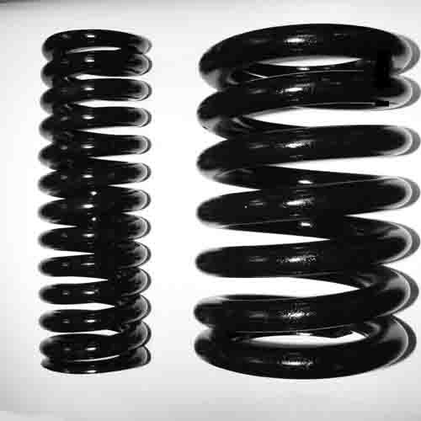
But TODAY…
…TODAY we are still a civilization of SPRING...

Slide 28
Are we alone with this problem?
Escape velocity energy of a typical planet habituated by chemistry-based creatures is ~ several eV/atom
Fundamentally constrained from below by need to retain an atmosphere and to be a “planet”
Ordinary matter & chemistry are the same everywhere
Most chemistry-based creatures are likely afraid of strong radiation
Energy of chemical bonds << energy of nuclear decay products
Deinococcus radiodurans is a notable exception & some hope
They would have difficulties with nuclear propulsion
Seems that getting into own planet’s orbit is a fundamental problem across our Universe

Slide 29
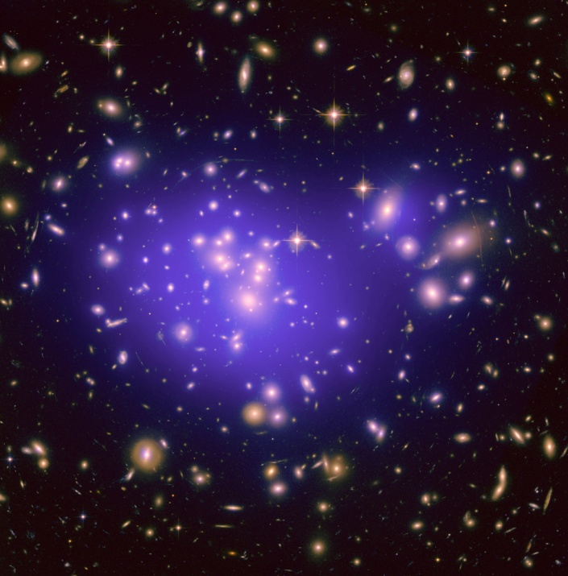
The perspective
In our Universe, there are:
Around 2*10¹¹ galaxies
10²² stars
10¹⁶ to 10²⁰ planets in habitable zones
If <a set of known and unknown pre-conditions> then between 0 and 10¹⁹ host or have hosted or will host soon chemistry-based intelligent life forms
So between 0 and 10¹⁶ civilizations co-exist with us NOW
Quite possibly, there is someone somewhere out there NOW thinking of exactly the same problem
Brothers in intelligence
But… “the winner takes it all!”

Slide 30
And as we search, we may find this…

Slide 31
Thank you for attention!

