Slide 1
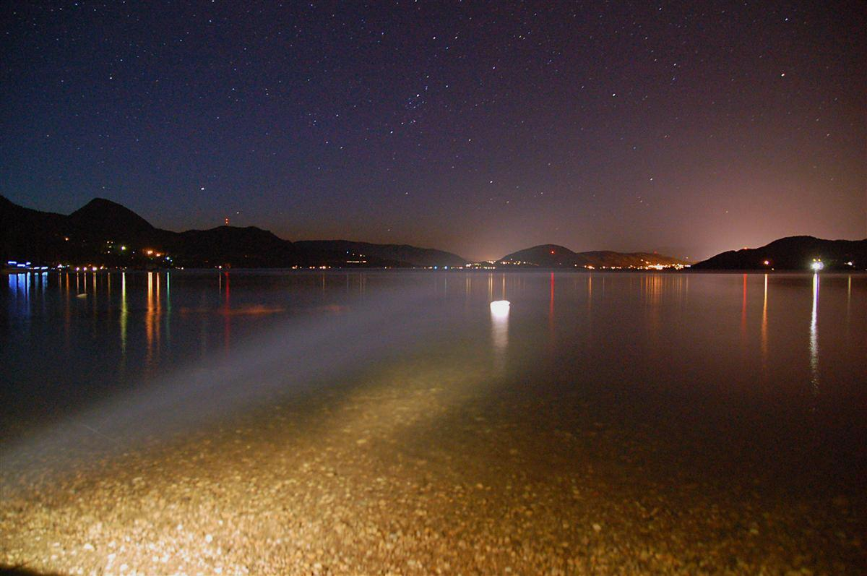
Is There Anybody… …Out There?
Are We Alone In the Universe?
This is a copyrighted derivative work owned by Eugene Bobukh and belonging to his Web site www.bobukh.com.
If you see it anywhere else, it must’ve been stolen. Commercial use without paying out royalties to the author is prohibited.
Notes:
Можно музыку обыграть

Slide 2
BREADTH

Slide 3
Part I The Context

Slide 4
Where Are We?

Slide 5
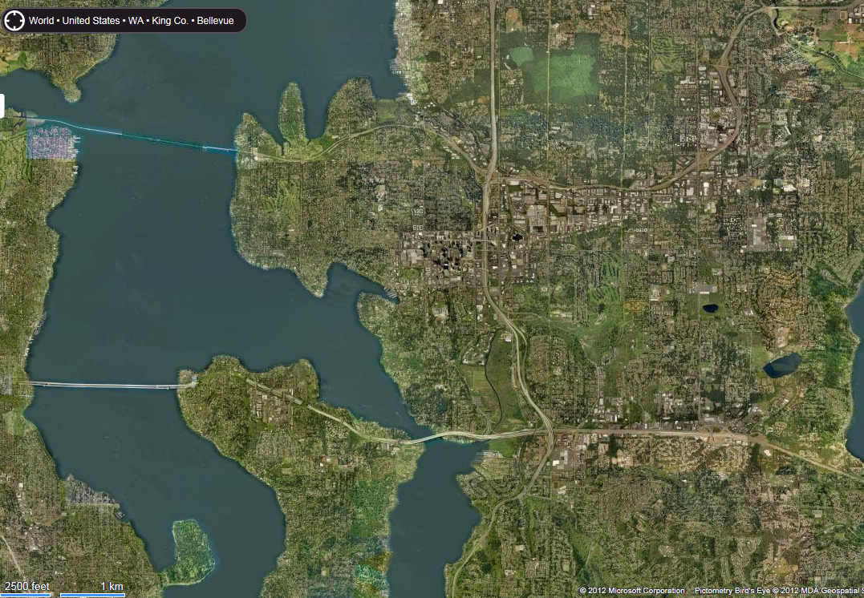
City
Bellevue
~10 km across
Communication time ~40 microsecond

Slide 6
Zoom out 1,000x
Earth
~12,000 km across
Travel time ~45 minutes
Communication time ~0.07 seconds

Slide 7
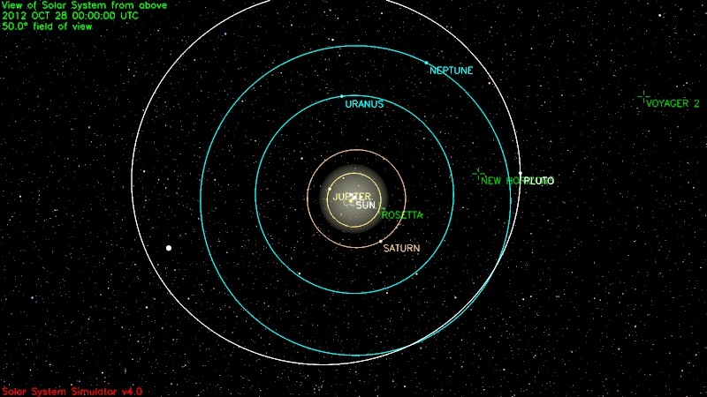
Zoom out 1,000,000x
Solar System
9 13 8 35 planets
~10 billion km across
Travel time ~10 years
Communication time ~1 day
Notes:
http://space.jpl.nasa.gov

Slide 8
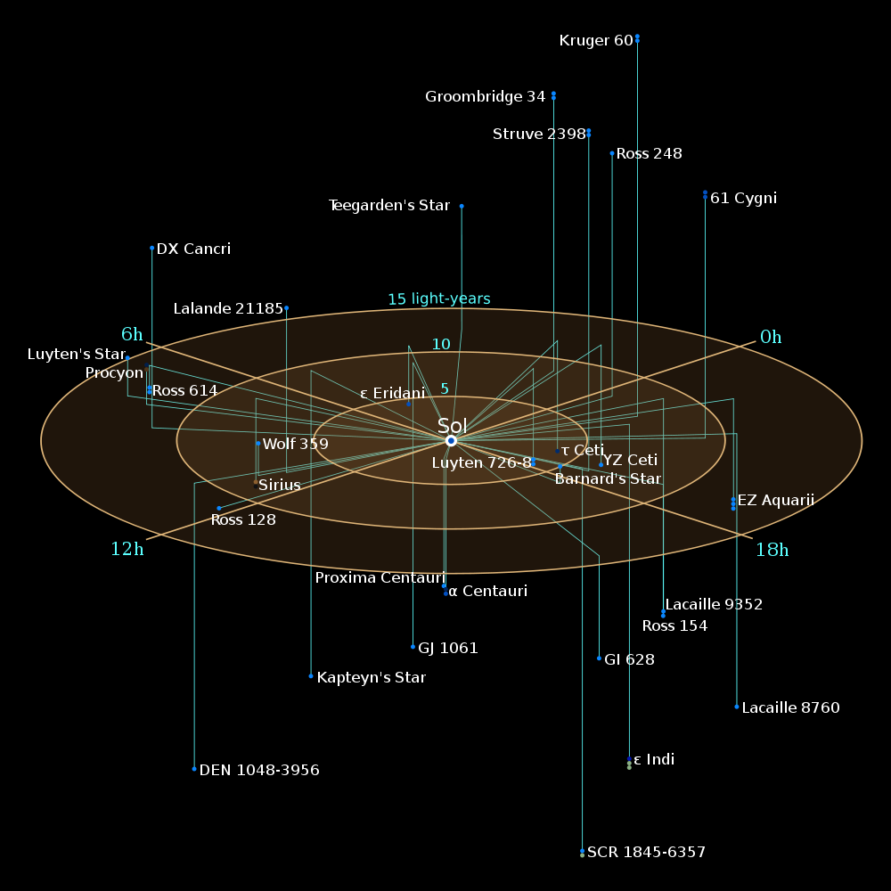
Zoom out 10,000x
Local stars neighborhood
~15 ly [light-years] across
~30 stars, 8x per each 2x in distance
The nearest: 4.2 ly away
Travel time ~300,000 years, communication time ~15 years
Notes:
http://www.cosmosportal.org/topics/view/11893/
http://en.wikipedia.org/wiki/List_of_nearest_stars

Slide 9
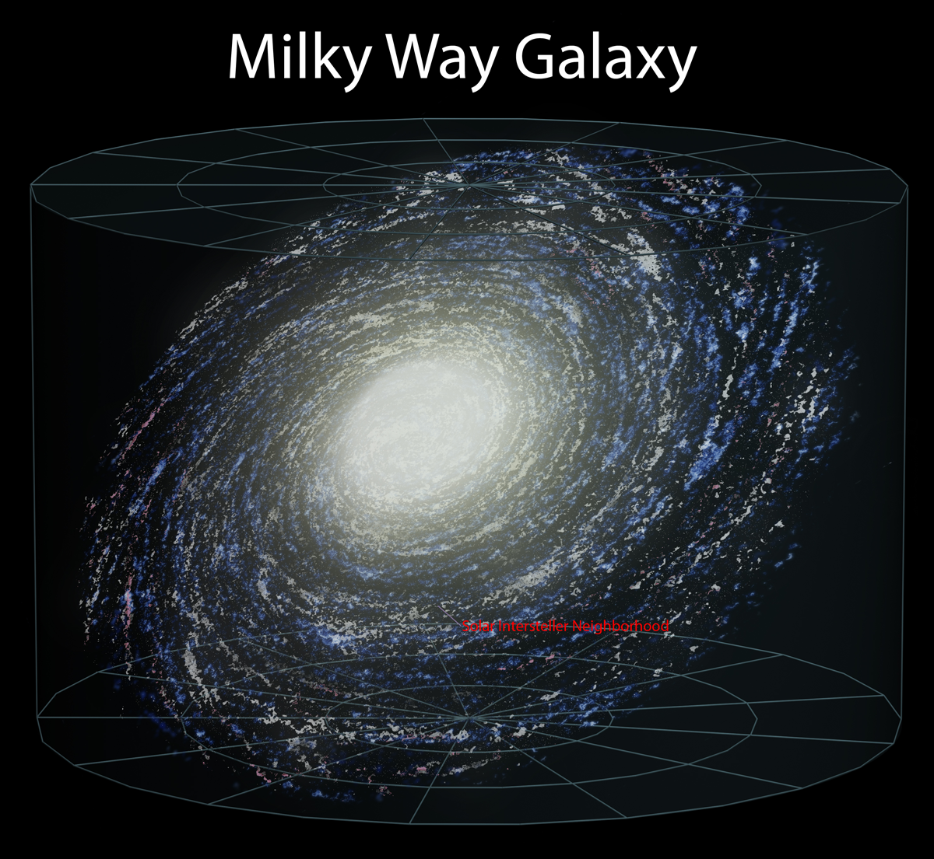
Zoom out 100x
Our Galaxy [AKA Milky Way]
~120,000 ly across
About 200 billion stars
Sun is ~27 kly from the center, in a relatively empty area between two arms
Galactic “year” ≈250 My

Slide 10
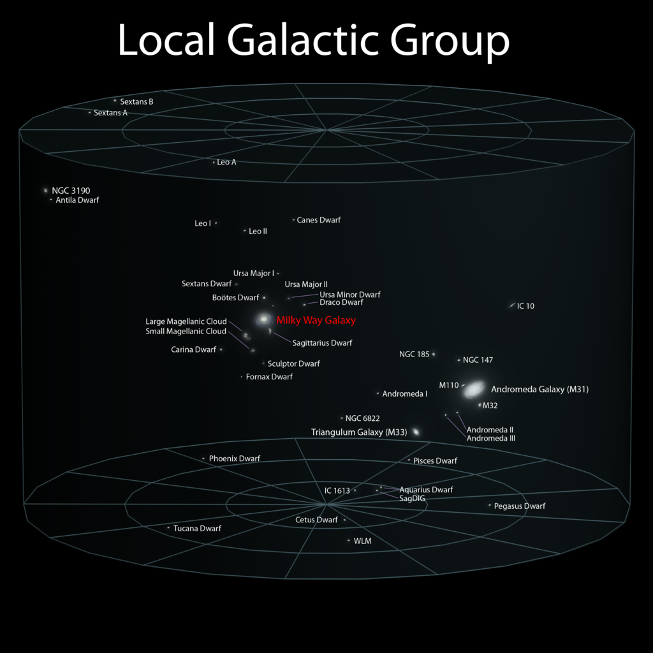
Zoom out 100x
Local Group
(in Virgo Supercluster)
~10 million ly (Mly) across
54 galaxies
Andromeda Galaxy 2 Mly away

Slide 11
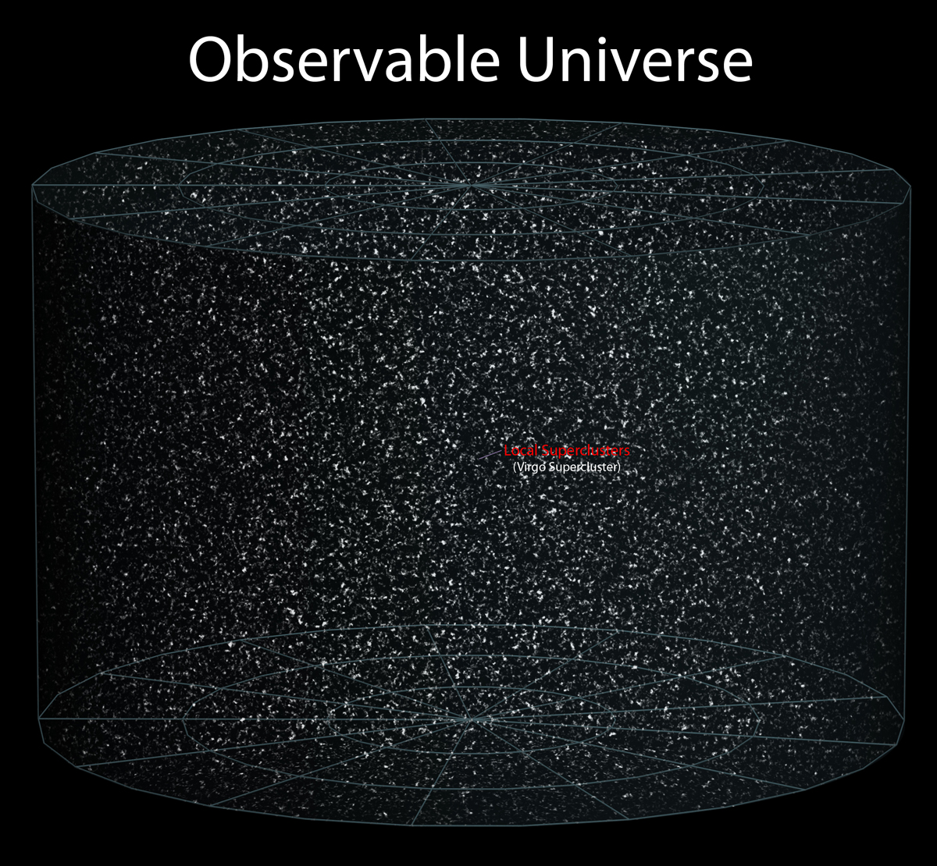
Zoom out 10,000x
Observable Universe
93 billion ly across (“distance” is very loaded at these scales)
“Points” are super-clusters of galaxies separated by tremendous voids
~80 billion galaxies, ~6*10²² stars
The end of where the light has propagated from since the onset of time, not of the Universe [which is probably some 10²³ times farther]

Slide 12
When Are We?

Slide 13
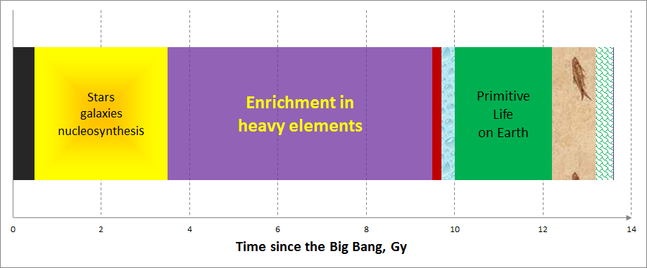
Universe Timeline
≈“Habitable” Universe ~10 Gy
Big Bang 13.6 Gya
“Strange” early Universe. Formation of time, space, mass, forces. Superluminal expansion, great annihilation. Birth of particles, H, D, He, decoupling of light (10⁻⁴³s – 380,000 years)
“Dark Ages”
Earth & Sun form
Crust, oceans,
cooldown, bombardment
Multicellular
life
Insects
Homo

Slide 14
Конечно. Человек не мог произойти от обезьяны. Он произошёл как минимум от двух обезьян. Enough on that.

Slide 15
Part II Problem Statement

Slide 16
Big Disconnection
Life possible for the past ~10 billion years
10¹¹ stars in our Galaxy old enough to have planets (10²² in the Universe)
If only a tiny fraction of stars are inhabited, Universe must be full of intelligent life!
Extrapolated super-civilizations
Super-civilizations must be visible across all the Galaxy
Interstellar spaceships gamma emission visible ~100s ly across
Dumping nuclear waste on the star detectable ~1000 ly
Self-replicating probes could’ve visited all our Galaxy in ~50 My
Radars 3-100 ly away
Tritium: several ly away
≠
Notes:
From http://en.wikipedia.org/wiki/Fermi_Principle

Slide 17
From Wiki:
“The apparent size and age of the universe suggest that many technologically advanced extraterrestrial civilizations ought to exist. However, this hypothesis seems inconsistent with the lack of observational evidence to support it.”
Notes:
From http://en.wikipedia.org/wiki/Fermi_Principle

Slide 18
Where is Everybody?

Slide 19
Fermi Paradox
From what we know, we expect to see “them”
Do we hear, see, sense anybody?
No
That, known as Fermi paradox, is the real problem:
What’s wrong with our picture of the Universe?
Notes:
From http://en.wikipedia.org/wiki/Fermi_Principle

Slide 20
<br>

Slide 21
Really-really nobody?
What about UFOs?

Slide 22
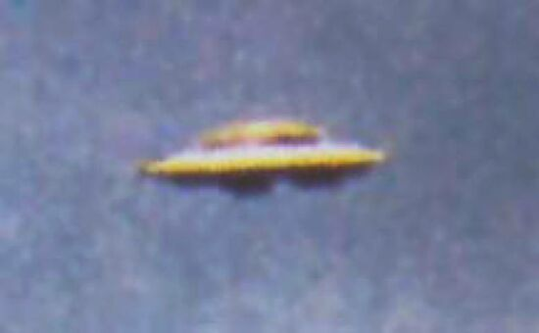
Maybe “they” visit us, in fact?

Slide 23
Basic (and mostly accepted) facts about UFOs
UFO Stands for:
Unidentified (true)
Flying (sometimes)
Object (sometimes)
Not for “Alien Spaceship” yet
Notes:
Medieval UFOs: http://science.howstuffworks.com/space/aliens-ufos/ufo-history2.htm ; http://www.violations.org.uk/medieval_ufos.html
Wikipedia: http://en.wikipedia.org/wiki/UFO; good list of notable sightings, from early history: http://en.wikipedia.org/wiki/List_of_UFO_sightings
Common signes: http://www.bibliotecapleyades.net/ciencia/ufo_briefingdocument/ifoufo.htm

Slide 24
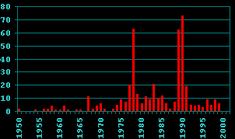
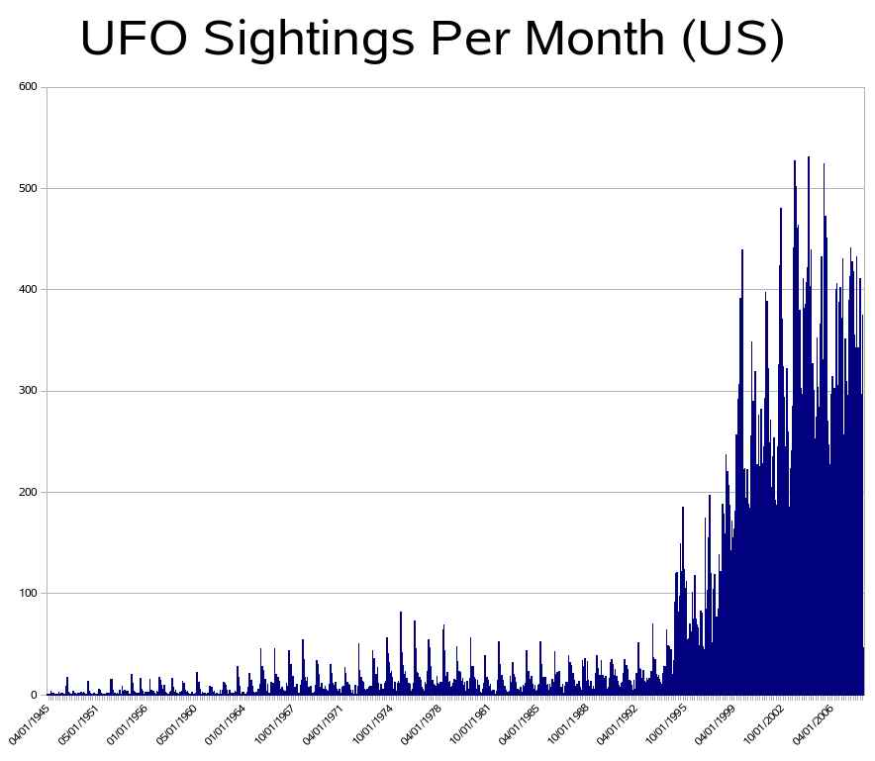
Basic (and mostly accepted) facts about UFOs
← USSR & Russia, per year
Large body of observations
“Modern” post-1947: hundreds of thousands cases
Many earlier sightings down to at least 9 AD
Notes:
Medieval UFOs: http://science.howstuffworks.com/space/aliens-ufos/ufo-history2.htm ; http://www.violations.org.uk/medieval_ufos.html
Wikipedia: http://en.wikipedia.org/wiki/UFO; good list of notable sightings, from early history: http://en.wikipedia.org/wiki/List_of_UFO_sightings
Common signes: http://www.bibliotecapleyades.net/ciencia/ufo_briefingdocument/ifoufo.htm

Slide 25
Basic (and mostly accepted) facts about UFOs
Governments do/did collect, analyze, and sometimes hide data
Dozens of projects publicly known in Wikipedia
As a result, any discussion is gravely contaminated with
Data gaps
Data leaks
Data “leaks” ☺
Conspiracies
Anti-conspiracies
Anti-anti-conspiracies
…ad infinitum
Notes:
Medieval UFOs: http://science.howstuffworks.com/space/aliens-ufos/ufo-history2.htm ; http://www.violations.org.uk/medieval_ufos.html
Wikipedia: http://en.wikipedia.org/wiki/UFO; good list of notable sightings, from early history: http://en.wikipedia.org/wiki/List_of_UFO_sightings
Common signes: http://www.bibliotecapleyades.net/ciencia/ufo_briefingdocument/ifoufo.htm

Slide 26
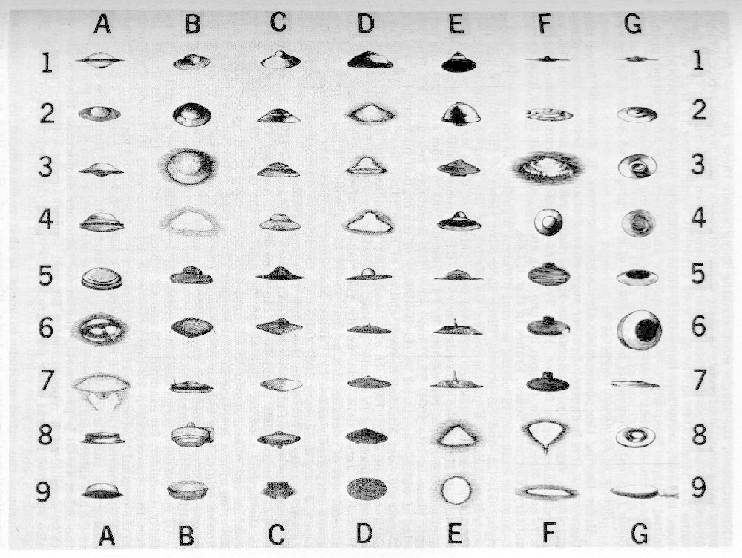
Basic (and mostly accepted) facts about UFOs, 1/3
Few common characteristics of UFOs:
Shape: disk, triangle, cylinder, sphere, dot
Often luminous
Some detectable by radar
May display extreme accelerations, sharp turns at enormous & supersonic apparent velocities
Generally silent, no sonic booms
Reports of electromagnetic interference
Few reports of close encouters or abductions
Notes:
Medieval UFOs: http://science.howstuffworks.com/space/aliens-ufos/ufo-history2.htm ; http://www.violations.org.uk/medieval_ufos.html
Wikipedia: http://en.wikipedia.org/wiki/UFO; good list of notable sightings, from early history: http://en.wikipedia.org/wiki/List_of_UFO_sightings
Common signs: http://www.bibliotecapleyades.net/ciencia/ufo_briefingdocument/ifoufo.htm

Slide 27
Basic (and less agreed upon) facts about UFOs
70%-98% observations could be explained after analysis with clean hands and clear mind:
Balloons, lanterns, aircraft, rockets, air ads
Astronomic: meteors, planets, stars
Atmospheric phenomena: rare clouds, halos, untypical lightings
Searchlights play
Bird flocks
Pranks & hoaxes (surprisingly, only few %)
About ~10% are hard to explain
Notes:
Interesting case: http://en.wikipedia.org/wiki/Kelly-Hopkinsville_encounter
Good list of interesting sightings: http://www.nerdygaga.com/10946/unidentified-flying-object/
Good sight on unusual aircraft: http://www.unrealaircraft.com/wings/wings.php

Slide 28
Consider Few Examples…

Slide 29
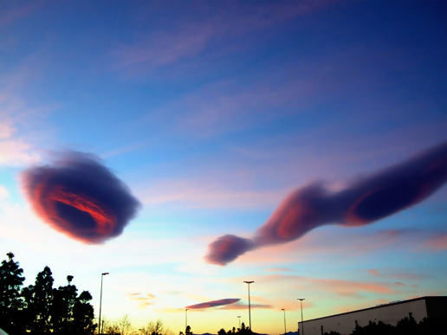
Clouds

Slide 30
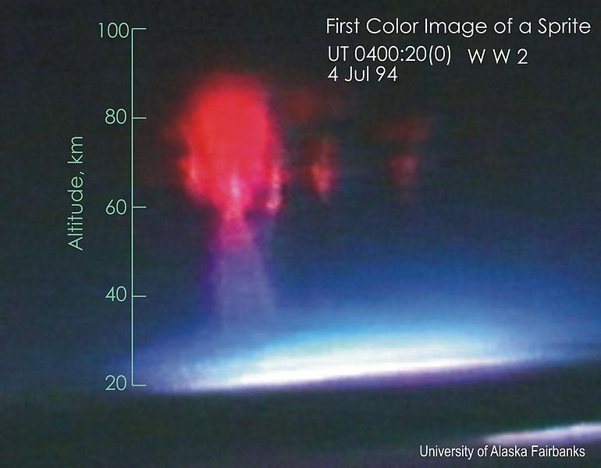
Sprite

Slide 31
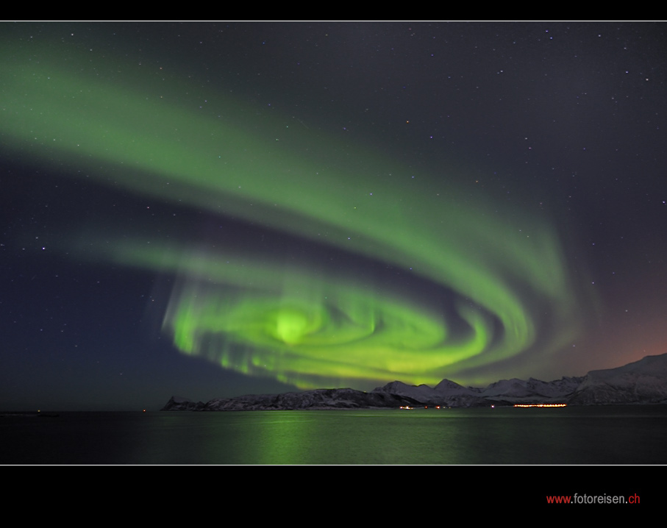
Aurora

Slide 32
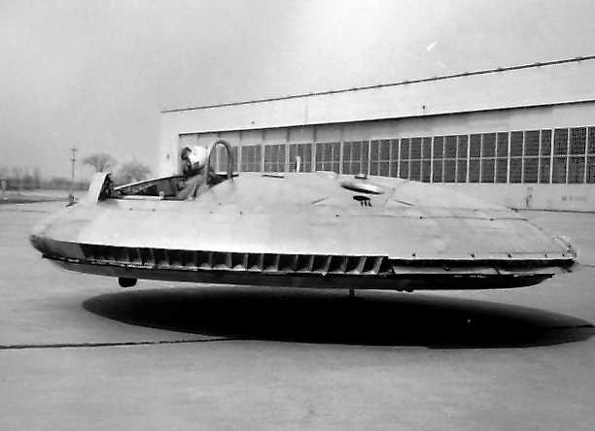
Avrocar (real)

Slide 33
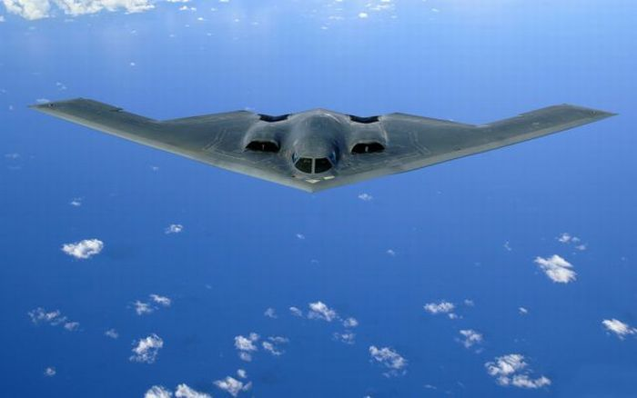
B 2 Bomber (real)

Slide 34
Beluga Aircraft (real)

Slide 35
E-2D Hawkeys (real)

Slide 36
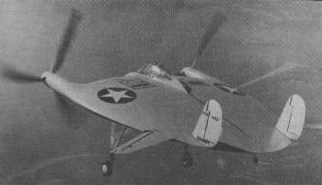
Chance Vought V-137 (real)

Slide 37
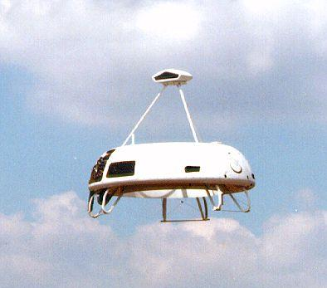
Sikorsky Cypher-UAV (real)

Slide 38
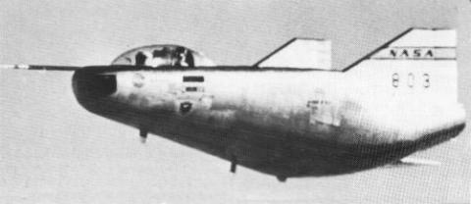
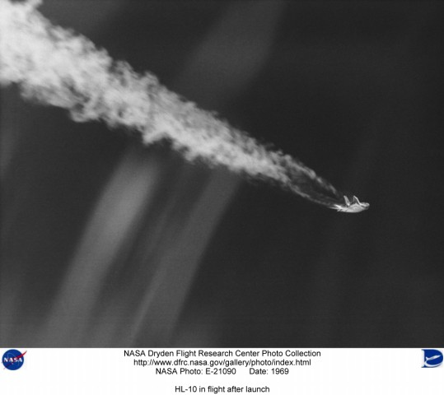
Lifting Body Aircraft (real)

Slide 39
“Common” Plane Landing

Slide 40
Halos

Slide 41
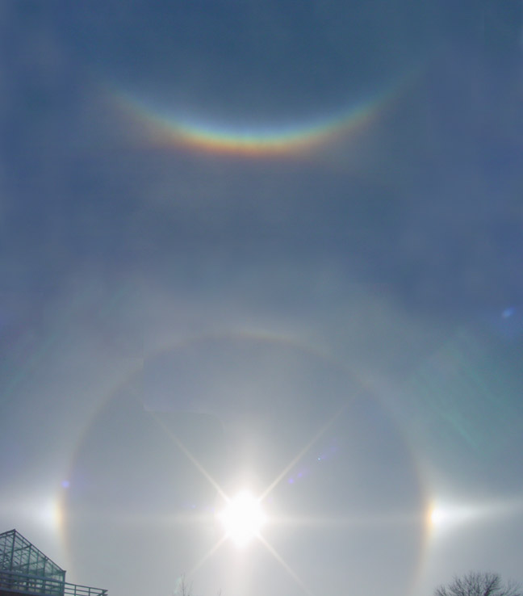
Halos

Slide 42
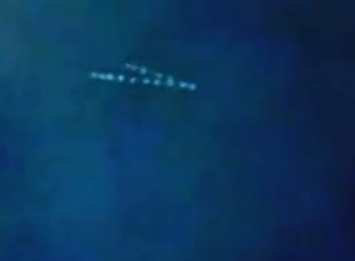
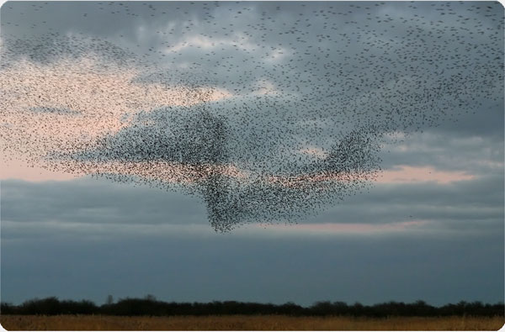
Bird Flocks

Slide 43
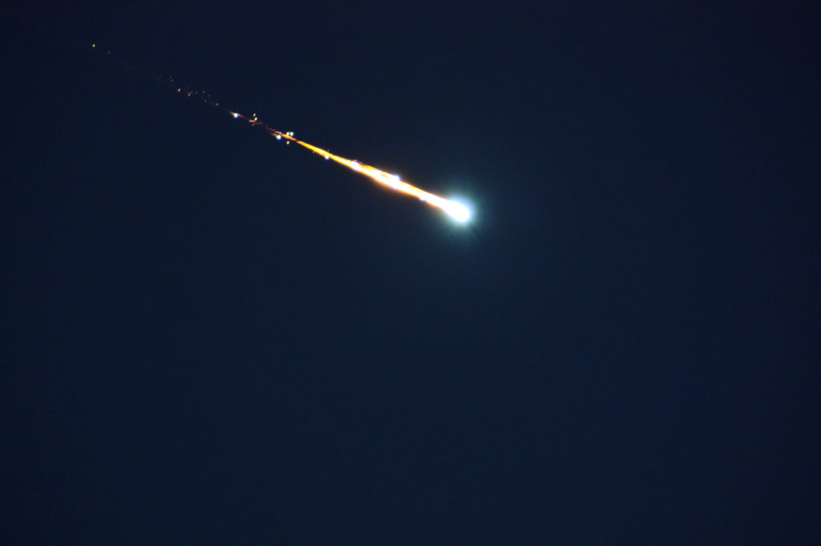
Meteorite (green)

Slide 44
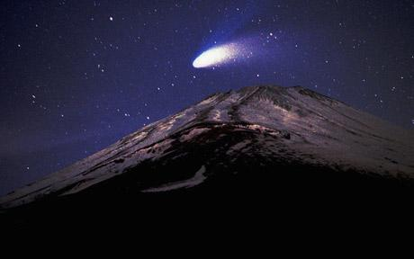
Hale-Bopp Comet

Slide 45
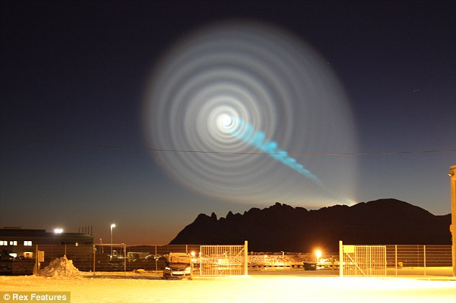
Rotating Rocket Dumping Fuel (“Norway Spiral”)

Slide 46
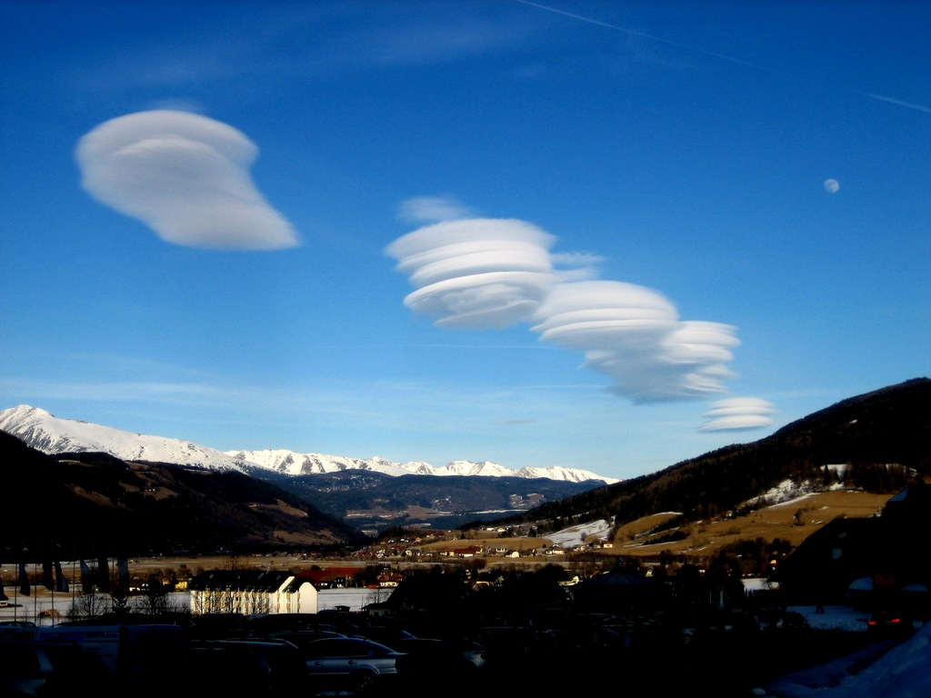
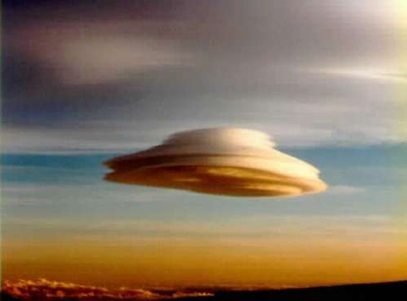
Lenticular Clouds

Slide 47
Sprite & Elve

Slide 48
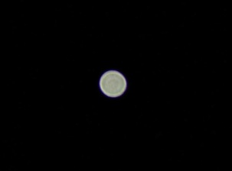
Venus, out of focus

Slide 49
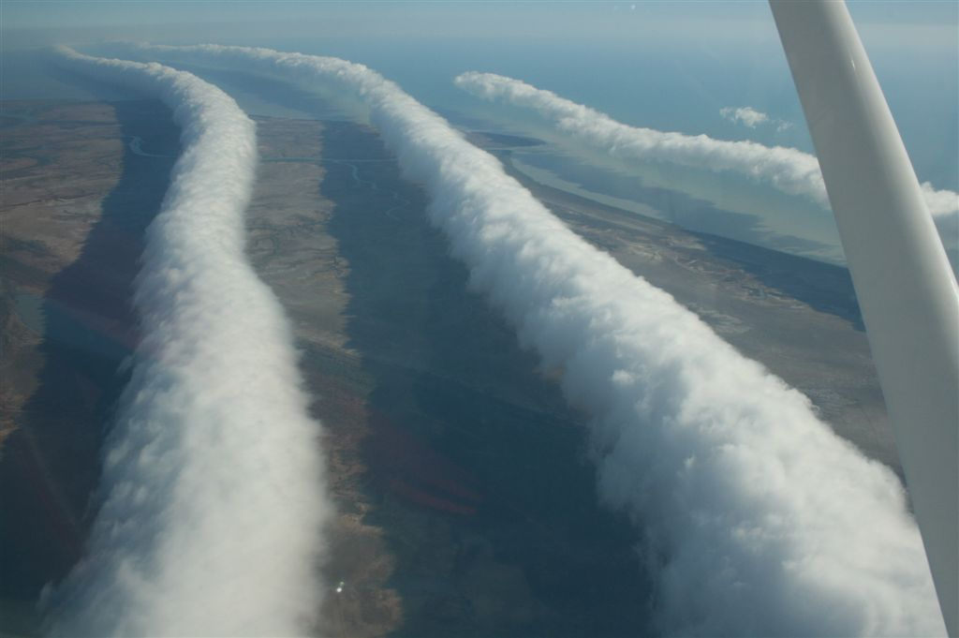
Rolling Clouds

Slide 50
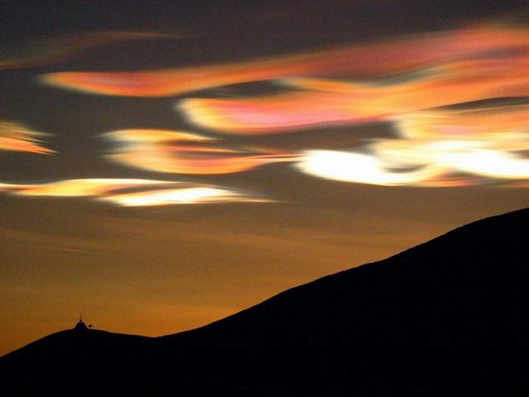
Nacreous Clouds
Very uncommon and beautiful…

Slide 51
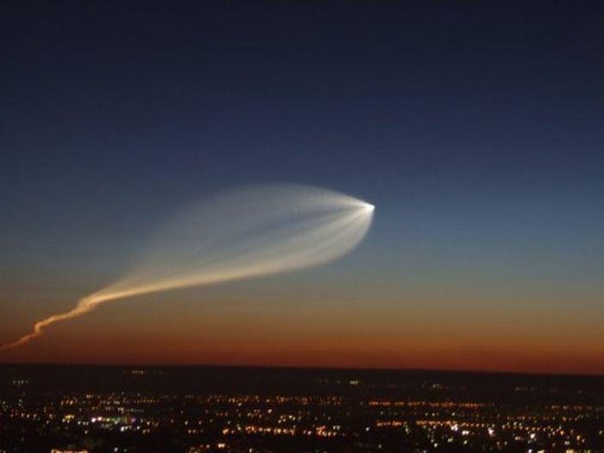
High Altitude Rocket Trace (“Петрозаводский феномен”)

Slide 52
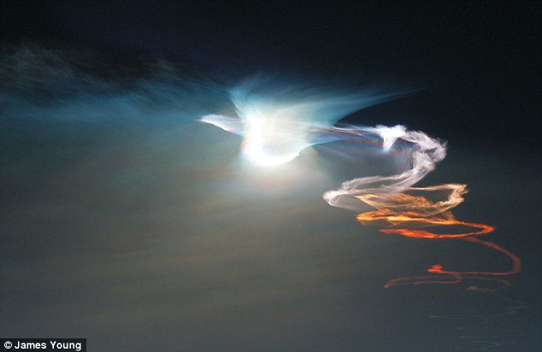
Another Rocket Trail

Slide 53
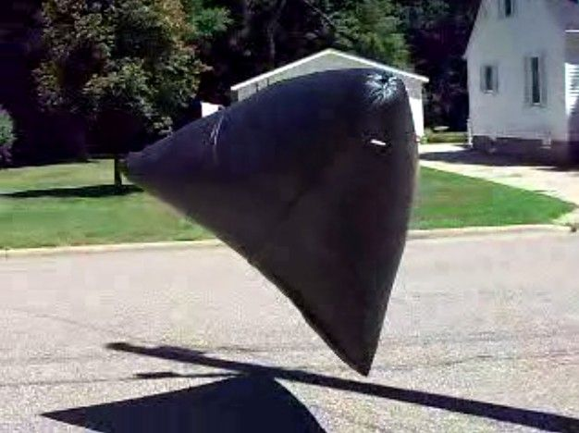
Solar Balloon [Trash Bags + Tape + Sun == Fun]

Slide 54
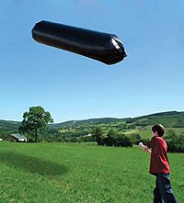
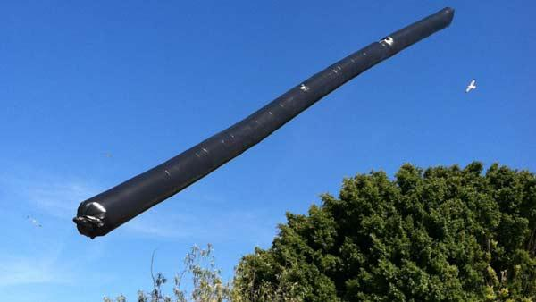
More Solar Balloons

Slide 55
Lanterns

Slide 56
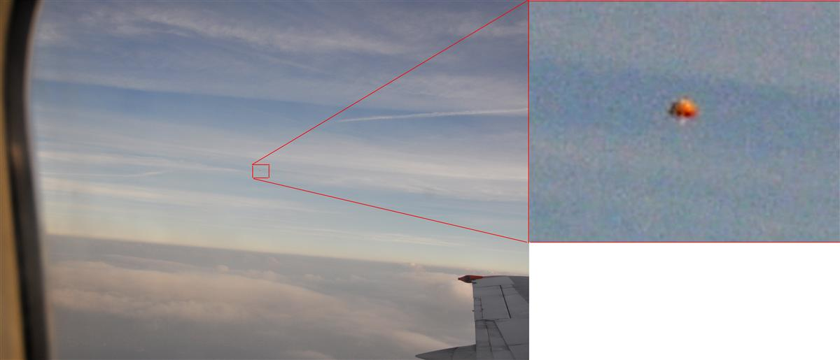
Regular Balloons
Seen from the airplane on approach to Moscow on 08/14/2010

Slide 57
Enough FUN?
Back to the unexplained 10%

Slide 58
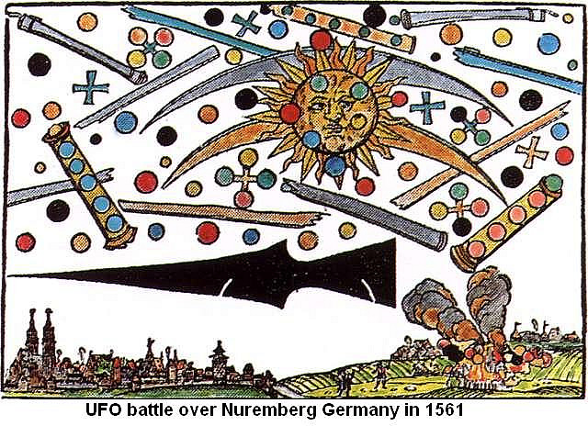
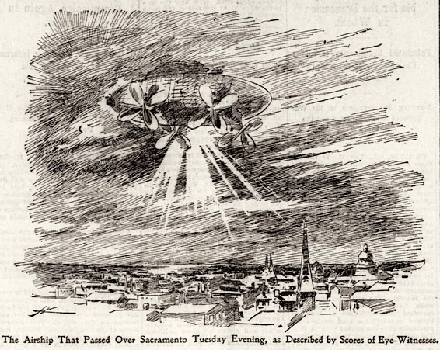
UFOs – far less known facts
UFOs observed in these years were interpreted as:
Before ~1800: “ships” with “sailors” and “anchors”; angels, dragons; crosses, “pipes”.
1890s-1910s: airships, dirigibles, even with pilots.
1947+: spaceships
Notes:
Frequency of UFO sighting in USSR/Russia: http://www.ufozone.h1.ru/uz_diag.shtml; similar stats for USA: http://www.openminds.tv/analyzing-august-2011-ufo-wave-802/ (interesting, the 11-year periodicity seems to hold!); UFO sightings data 1947-1952: http://www.unexplained-mysteries.com/forum/index.php?showtopic=181191; http://www.nuforc.org/ seems to carry some reporting back to 1910s; http://goinghomesoon.com/images/full/october/ufo_sightings_chart.jpg; this finally has good stats on explained/unexplained: http://www.cnes-geipan.fr/index.php?id=196 ; telescope sales: http://www.cloudynights.com/ubbthreads/showflat.php/Cat/1,2,3,4,5,8,9,10/Number/4058371/Main/4045525 ; sensors sales data http://www.bis.doc.gov/news/2006/wholereportwithappendices10_12_06.pdf ; http://www.numberof.net/number-of-airline-passengers-per-year/

Slide 59
Rorschach Test
Neither dragons
Nor ships
Nor dirigibles
Nor spaceships
Something completely beyond our current comprehension
Cultural “unconscious”
Notes:
Frequency of UFO sighting in USSR/Russia: http://www.ufozone.h1.ru/uz_diag.shtml; similar stats for USA: http://www.openminds.tv/analyzing-august-2011-ufo-wave-802/ (interesting, the 11-year periodicity seems to hold!); UFO sightings data 1947-1952: http://www.unexplained-mysteries.com/forum/index.php?showtopic=181191; http://www.nuforc.org/ seems to carry some reporting back to 1910s; http://goinghomesoon.com/images/full/october/ufo_sightings_chart.jpg; this finally has good stats on explained/unexplained: http://www.cnes-geipan.fr/index.php?id=196 ; telescope sales: http://www.cloudynights.com/ubbthreads/showflat.php/Cat/1,2,3,4,5,8,9,10/Number/4058371/Main/4045525 ; sensors sales data http://www.bis.doc.gov/news/2006/wholereportwithappendices10_12_06.pdf ; http://www.numberof.net/number-of-airline-passengers-per-year/

Slide 60
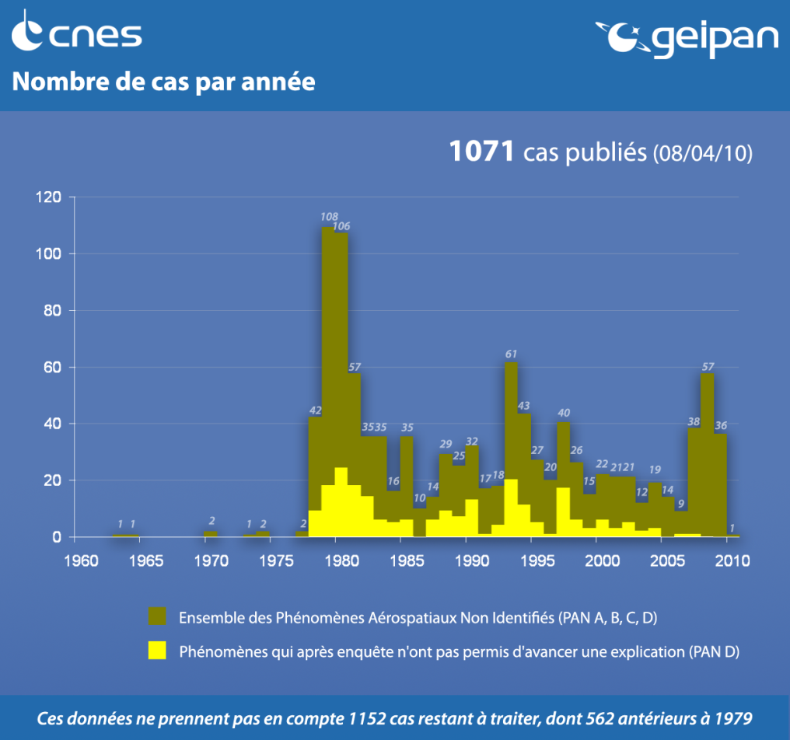
UFOs – far less known facts
Rate of UFOs observations fluctuates by an order of magnitude between years. Faction of unexplained ones does not.
Conclusion?
Notes:
Frequency of UFO sighting in USSR/Russia: http://www.ufozone.h1.ru/uz_diag.shtml; similar stats for USA: http://www.openminds.tv/analyzing-august-2011-ufo-wave-802/ (interesting, the 11-year periodicity seems to hold!); UFO sightings data 1947-1952: http://www.unexplained-mysteries.com/forum/index.php?showtopic=181191; http://www.nuforc.org/ seems to carry some reporting back to 1910s; http://goinghomesoon.com/images/full/october/ufo_sightings_chart.jpg; this finally has good stats on explained/unexplained: http://www.cnes-geipan.fr/index.php?id=196 ; telescope sales: http://www.cloudynights.com/ubbthreads/showflat.php/Cat/1,2,3,4,5,8,9,10/Number/4058371/Main/4045525 ; sensors sales data http://www.bis.doc.gov/news/2006/wholereportwithappendices10_12_06.pdf ; http://www.numberof.net/number-of-airline-passengers-per-year/

Slide 61
Two explanations possible
A
Most unexplained sightings are of extraterrestrial nature. The rate fluctuates due to people paying more attention some years.
Prediction: using higher quality tools (telescopes, good cameras) will boost the confidence and quality of these observations.
B
Extraterrestrial ships are less than 1-2% of observations. The majority of unexplained cases are natural or man-made objects misidentified due to the difficulties in observation.
Prediction: increase in observation tools quality will boost the total number of encounters, but will not change the proportion and quality of unexplained sightings.

Slide 62
Lets test it: YouTube + Digital Era
800,000,000 passenger airplane flights in 2008
140 million YouTube videos
In 2001 several random people have videoed 9/11 attack
When Columbia disintegrated at space boundary in 2003, there was enough good amateur footage for NASA to use
Worldwide digital cameras sales: 5.5M in 1999; 50M in 2003; 120M in 2009
US yearly sales:
Amateur telescopes: 300,000 (2010)
“Advanced” amateur telescopes: 10,000 (2010)
IR cameras & sensors, non-defense: 390,000 (2005)
Night vision devices, non-defense: 130,000 (2005)
Yet most UFO videos on YouTube are still of poor quality, featuring spots, dots, & blurry shapes
Though I admit: there are very few of higher quality that I find hard to explain
Unexplained rate: same as in 1950s
Notes:
Frequency of UFO sighting in USSR/Russia: http://www.ufozone.h1.ru/uz_diag.shtml; similar stats for USA: http://www.openminds.tv/analyzing-august-2011-ufo-wave-802/ (interesting, the 11-year periodicity seems to hold!); UFO sightings data 1947-1952: http://www.unexplained-mysteries.com/forum/index.php?showtopic=181191; http://www.nuforc.org/ seems to carry some reporting back to 1910s; http://goinghomesoon.com/images/full/october/ufo_sightings_chart.jpg; this finally has good stats on explained/unexplained: http://www.cnes-geipan.fr/index.php?id=196 ; telescope sales: http://www.cloudynights.com/ubbthreads/showflat.php/Cat/1,2,3,4,5,8,9,10/Number/4058371/Main/4045525 ; sensors sales data http://www.bis.doc.gov/news/2006/wholereportwithappendices10_12_06.pdf ; http://www.numberof.net/number-of-airline-passengers-per-year/
Camera sales: http://www.dpreview.com/news/2004/1/26/pmaresearch2003sales, http://www.dcresource.com/news/newsitem.php?id=3862

Slide 63
My personal conclusion on the nature of UFOs
Yes, some eerie and strange cases exist (e.g., http://en.wikipedia.org/wiki/Kelly-Hopkinsville_encounter), but overall…
% | Class
70%-95% | Natural or man-made phenomena, enhanced by distorted perception and psychic reactions
5%-30% | Misidentifications or some unknown phenomena which we attribute to demons, dirigibles, or spaceships per current level of development, but which is neither of them
<1% | Extraterrestrial spaceships, if any
The worst part: none of that ~1% so far looks consistent enough to help with Fermi paradox
Notes:
Frequency of UFO sighting in USSR/Russia: http://www.ufozone.h1.ru/uz_diag.shtml; similar stats for USA: http://www.openminds.tv/analyzing-august-2011-ufo-wave-802/ (interesting, the 11-year periodicity seems to hold!); UFO sightings data 1947-1952: http://www.unexplained-mysteries.com/forum/index.php?showtopic=181191; http://www.nuforc.org/ seems to carry some reporting back to 1910s; http://goinghomesoon.com/images/full/october/ufo_sightings_chart.jpg; this finally has good stats on explained/unexplained: http://www.cnes-geipan.fr/index.php?id=196 ; telescope sales: http://www.cloudynights.com/ubbthreads/showflat.php/Cat/1,2,3,4,5,8,9,10/Number/4058371/Main/4045525 ; sensors sales data http://www.bis.doc.gov/news/2006/wholereportwithappendices10_12_06.pdf ; http://www.numberof.net/number-of-airline-passengers-per-year/

Slide 64
OK, maybe we really start looking for “them” up there ?

Slide 65
…технічна перерва…

Slide 66
Part III Searching: what, how far, how long?

Slide 67
What is life?
Our definitions are rather blurry

Slide 68
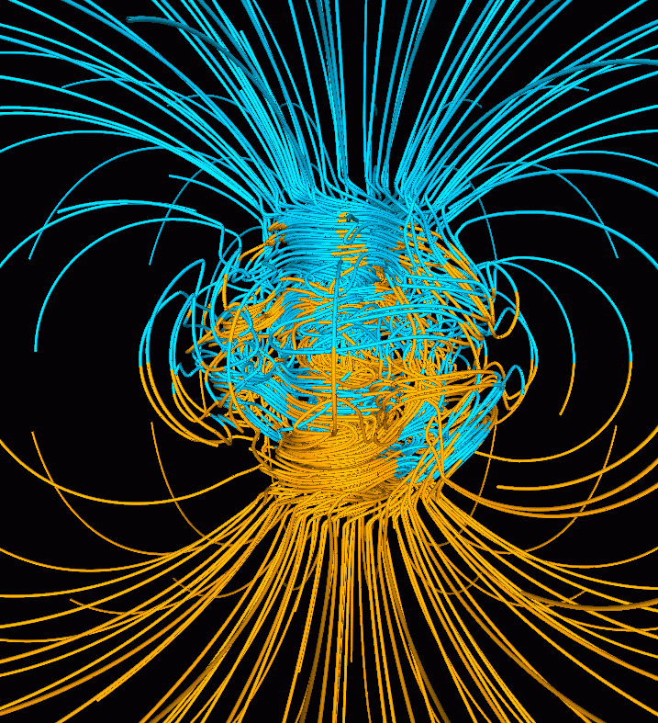
Earth Magnetic Dynamo
Magnetic field thrives on the energy of convection, bending flows such as to self-increase!
We still don’t fully understand it.

Slide 69
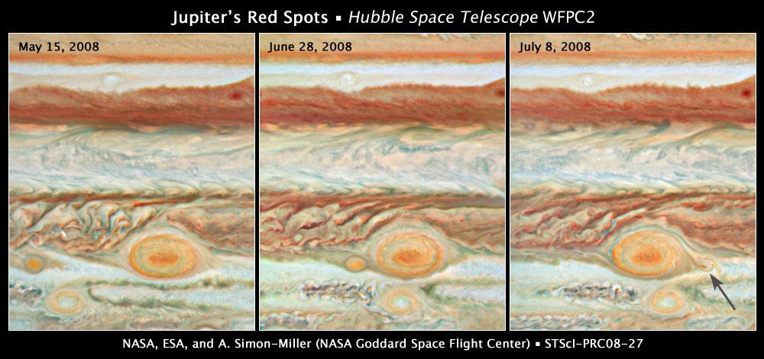
Jupiter storms
Exist for 100s years and “eat” each other. Complex dynamics.
Notes:
Good one on waves http://science.kennesaw.edu/~jdirnber/oceanography/LecuturesOceanogr/LecWaves/LecWaves.html

Slide 70
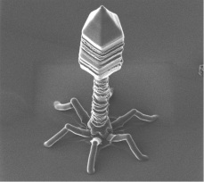
Viruses
Not made of cells
Have no metabolism
But… they replicate, and evolve.
And are pretty complex <creatures? beings? things? mechanisms?>

Slide 71
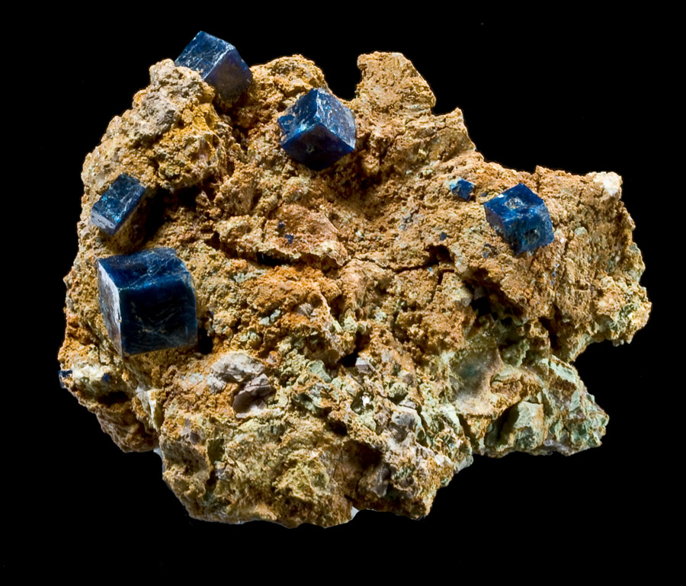
Crystals
Grow by competing for resources with each other and other types of crystals

Slide 72
Computer malware
Complex structure
Replication
Self-defense
Mutation

Slide 73
Does life have to be carbon-based?

Slide 74
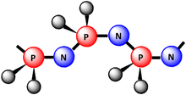
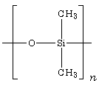
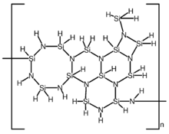
Probably Not
DNA backbone: [Sugar-O-(PO₂)-O-]_{n}
Metal-oxygen polymers
[-Ge-]_{n}, [-Sn]_{n} (“дубли ☺”)
Notes:
http://en.wikipedia.org/wiki/Dna, http://en.wikipedia.org/wiki/Inorganic_polymer

Slide 75
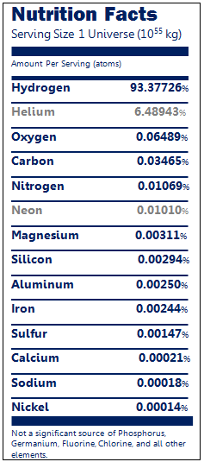
Abundances & chances?
“Cosmic” abundances non-favorable for non-CBLF:
Nitrogen 3x less common than Carbon
Silicon 12x
Sulfur 24x
Phosphorus 1200x
Boron 470,000x
Earth [“rocky planets”] look better:
Oxygen 63%
Silicon 22%
…
Carbon 0.13%
Sulfur 0.056%
Phosphorus 0.056%
Nitrogen 0.0097%
Boron 0.0023%
So on hot planets, Si-O may be promising

Slide 76
What is Intelligence?

Slide 77
No surprise, we don’t know either
Over 10 definitions on Wiki, all fail
Today, machines can do most of what was considered “essential” part of intelligence just 100 years ago
Calculate
Read
Navigate
Speak
Play chess
Image recognition
Pass the Turing test

Slide 78
My gestalt
“Тут на трибуну взобрался интеллектуал-лирик с тремя подбородками и галстуком-бабочкой, рванул себя безжалостно за крахмальную манишку и рыдающе провозгласил: "Я не могу... Я не хочу этого... Розовое дитя, играющее погремушечкой... плакучие ивы, склоняющиеся к пруду... девочки в беленьких фартучках... Они читают стихи... они плачут... плачут!.. Над прекрасной строкой поэта... Я не желаю, чтобы электронное железо погасило эти глаза... эти губы... эти юные робкие перси... Нет, не станет машина умнее человека! Потому что я... потому что мы... Мы не хотим этого! И этого не будет никогда! Никогда!! Никогда!!!"
К нему потянулись со стаканами воды, а в четырехстах километрах над его снежными кудрями беззвучно, мертво, зорко прошел, нестерпимо блестя, автоматический спутник-истребитель, начиненный ядерной взрывчаткой...”
АБС, 1965

Slide 79
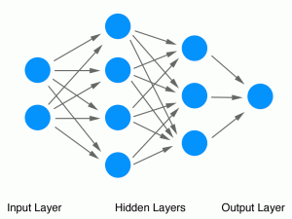
Artificial Neural Networks
With ~50 neurons, find solutions that *I* can’t interpret and that work *better* than my theories!
Notes:
http://sprott.physics.wisc.edu/pubs/paper232.htm

Slide 80
Could these be intelligent?
Mountains
Just very slow
Magnetic dynamo or smoke turbulence
Just no communication channels
Notes:
Good one on waves http://science.kennesaw.edu/~jdirnber/oceanography/LecuturesOceanogr/LecWaves/LecWaves.html

Slide 81
R-R-R-RELAX
Likely, none of them are intelligent
My point is different:
It is hard to impossible to reason about intelligence of creatures that are sufficiently different from us

Slide 82
Conclusion
We are bound to search for only what we can comprehend
Probably a tiniest spot in a vast space of possibilities
Probably just “там, где светло”

Slide 83
Detection radius
How far could we see “them” if “they” were exactly like us?

Slide 84
Tribal (30K years ago)
Australian aboriginal language map
Different colors are different language families
Detection radius ≈size of language family territory ~100-1000 km
Notes:
Language families: http://en.wikipedia.org/wiki/Language_family and in Australia http://en.wikipedia.org/wiki/Indigenous_Australian_languages (22 language FAMILIES!) Or, this is perfect: http://en.wikipedia.org/wiki/List_of_Australian_Aboriginal_languages
http://en.wikipedia.org/wiki/Sino-Roman_relations http://www.sacred-texts.com/astro/ml/ml19.htm (on Moon’s habitability) http://www.antiquespectacles.com/telescopes/telescopes.htm (telescopes resolution history) http://en.wikipedia.org/wiki/History_of_London ; history of canals http://en.wikipedia.org/wiki/Canals ; telescope limiting at http://www.cruxis.com/scope/limitingmagnitude.htm; early projects on communication with Martians: http://weirdaustralia.com/2011/10/28/communicating-with-martians-early-20th-century-musings-on-our-interplanetary-neighbours/ ; Detectability of Extraterrestrial Technological Activities: http://www.coseti.org/lemarch1.htm ; http://setifaq.org/faq.html#1.2.3 (SETI FAQ; some on TV detection).

Slide 85
Ancient
167 AD: First contacts between Rome and China
~8000 km by land
Sea fare still limited
Notes:
Language families: http://en.wikipedia.org/wiki/Language_family and in Austalia http://en.wikipedia.org/wiki/Indigenous_Australian_languages (22 language FAMILIES!) Or, this is perfect: http://en.wikipedia.org/wiki/List_of_Australian_Aboriginal_languages
http://en.wikipedia.org/wiki/Sino-Roman_relations http://www.sacred-texts.com/astro/ml/ml19.htm (on Moon’s habitability) http://www.antiquespectacles.com/telescopes/telescopes.htm (telescopes resolution history) http://en.wikipedia.org/wiki/History_of_London ; history of canals http://en.wikipedia.org/wiki/Canals ; telescope limiting at http://www.cruxis.com/scope/limitingmagnitude.htm; early projects on communication with Martians: http://weirdaustralia.com/2011/10/28/communicating-with-martians-early-20th-century-musings-on-our-interplanetary-neighbours/ ; Detectability of Extraterrestrial Technological Activities: http://www.coseti.org/lemarch1.htm ; http://setifaq.org/faq.html#1.2.3 (SETI FAQ; some on TV detection).

Slide 86
1522: Magellan’s voyage
20,000 km
If there was another European-like civilization anywhere on the globe, it would’ve been discovered by that time.
Notes:
Language families: http://en.wikipedia.org/wiki/Language_family and in Austalia http://en.wikipedia.org/wiki/Indigenous_Australian_languages (22 language FAMILIES!) Or, this is perfect: http://en.wikipedia.org/wiki/List_of_Australian_Aboriginal_languages
http://en.wikipedia.org/wiki/Sino-Roman_relations http://www.sacred-texts.com/astro/ml/ml19.htm (on Moon’s habitability) http://www.antiquespectacles.com/telescopes/telescopes.htm (telescopes resolution history) http://en.wikipedia.org/wiki/History_of_London ; history of canals http://en.wikipedia.org/wiki/Canals ; telescope limiting at http://www.cruxis.com/scope/limitingmagnitude.htm; early projects on communication with Martians: http://weirdaustralia.com/2011/10/28/communicating-with-martians-early-20th-century-musings-on-our-interplanetary-neighbours/ ; Detectability of Extraterrestrial Technological Activities: http://www.coseti.org/lemarch1.htm ; http://setifaq.org/faq.html#1.2.3 (SETI FAQ; some on TV detection).

Slide 87
1600-1650s change
Invention of workable telescope
Heliocentric system takes over
Bruno's idea of multiple worlds
“Somnium”, first space “sci-fi” (1630)
First culture on Earth with sufficient “strata” of people capable of adequate contact with aliens visiting Earth.
Prior to that, they would’ve been perceived as supernatural beings. There was no “shelf” for them within the prior world picture.
Beginning of “contemporary” civilization.
Notes:
Language families: http://en.wikipedia.org/wiki/Language_family and in Austalia http://en.wikipedia.org/wiki/Indigenous_Australian_languages (22 language FAMILIES!) Or, this is perfect: http://en.wikipedia.org/wiki/List_of_Australian_Aboriginal_languages
http://en.wikipedia.org/wiki/Sino-Roman_relations http://www.sacred-texts.com/astro/ml/ml19.htm (on Moon’s habitability) http://www.antiquespectacles.com/telescopes/telescopes.htm (telescopes resolution history) http://en.wikipedia.org/wiki/History_of_London ; history of canals http://en.wikipedia.org/wiki/Canals ; telescope limiting at http://www.cruxis.com/scope/limitingmagnitude.htm; early projects on communication with Martians: http://weirdaustralia.com/2011/10/28/communicating-with-martians-early-20th-century-musings-on-our-interplanetary-neighbours/ ; Detectability of Extraterrestrial Technological Activities: http://www.coseti.org/lemarch1.htm ; http://setifaq.org/faq.html#1.2.3 (SETI FAQ; some on TV detection).

Slide 88
1650-1820: 400,000 km
“In November 1609 he <Galileo> built a superior telescope with almost 30X magnification” ⬄ to 8 km city on the Moon.
London Ø is ~1 mile in 1610s; ~3 miles by 1745; ~5 miles by 1800.
1657: Huygens’ 100x telescope can see 2.2 km city on the Moon.
By 1812, Fraunhofer had succeeded in creating an achromatic objective lens 190 mm (7.5 in) in diameter.”
“In 1822 Franz von Gruithuisen thought he saw a giant city and evidence of agriculture on the moon, but astronomers using more powerful instruments refuted his claims”
Fraunhofer’s observations 1823
Notes:
Language families: http://en.wikipedia.org/wiki/Language_family and in Austalia http://en.wikipedia.org/wiki/Indigenous_Australian_languages (22 language FAMILIES!) Or, this is perfect: http://en.wikipedia.org/wiki/List_of_Australian_Aboriginal_languages
http://en.wikipedia.org/wiki/Sino-Roman_relations http://www.sacred-texts.com/astro/ml/ml19.htm (on Moon’s habitability) http://www.antiquespectacles.com/telescopes/telescopes.htm (telescopes resolution history) http://en.wikipedia.org/wiki/History_of_London ; history of canals http://en.wikipedia.org/wiki/Canals ; telescope limiting at http://www.cruxis.com/scope/limitingmagnitude.htm; early projects on communication with Martians: http://weirdaustralia.com/2011/10/28/communicating-with-martians-early-20th-century-musings-on-our-interplanetary-neighbours/ ; Detectability of Extraterrestrial Technological Activities: http://www.coseti.org/lemarch1.htm ; http://setifaq.org/faq.html#1.2.3 (SETI FAQ; some on TV detection).

Slide 89
1890-1940: 50 million km
Telescopes can resolve canals ~5x200 km (with dark vegetation) on Mars by late 1890s
Qaraqum canal on the left
Chicago city lights visible on Venus night side by ~1940s [if it was there]
Various projects (mirrors, etc.) for communicating with Martians in 1870s – 1920s
Notes:
Language families: http://en.wikipedia.org/wiki/Language_family and in Austalia http://en.wikipedia.org/wiki/Indigenous_Australian_languages (22 language FAMILIES!) Or, this is perfect: http://en.wikipedia.org/wiki/List_of_Australian_Aboriginal_languages
http://en.wikipedia.org/wiki/Sino-Roman_relations http://www.sacred-texts.com/astro/ml/ml19.htm (on Moon’s habitability) http://www.antiquespectacles.com/telescopes/telescopes.htm (telescopes resolution history) http://en.wikipedia.org/wiki/History_of_London ; history of canals http://en.wikipedia.org/wiki/Canals ; telescope limiting at http://www.cruxis.com/scope/limitingmagnitude.htm; early projects on communication with Martians: http://weirdaustralia.com/2011/10/28/communicating-with-martians-early-20th-century-musings-on-our-interplanetary-neighbours/ ; Detectability of Extraterrestrial Technological Activities: http://www.coseti.org/lemarch1.htm ; http://setifaq.org/faq.html#1.2.3 (SETI FAQ; some on TV detection).

Slide 90
What about life on Mars?
Time | Events | Conditions on Mars
4.6 – 4.1 Gya | Formation, bombardment | Non-habitable
4.1 – (3.5…3.0) Gya | Volcanism, warm dense atmosphere, large bodies of liquid water | Similar to Earth at the time, likely good for life formation
(3.5…3.0) Gya – now | Decline of volcanism, cooling down, loss of atmosphere & liquid water | Cold, dry, sterilized, nearly airless, “населён роботами” Potentially suitable for life only at depths >~10 km
Conclusion: either extinct, or primitive forms underground
(like our endoliths)
Notes:
http://en.wikipedia.org/wiki/Geological_history_of_Mars

Slide 91
The rest of the Solar System?
Moon was being contaminated since 1959
Good chances for icy moons Europa, Enceladus, Titan
Neptune, Uranus (deep in their atmospheres) may look interesting
Clearly no intelligent life even remotely similar to ours
Need to search farther. At other stars.

Slide 92
1992: several ly
Left: USA’s Ballistic Missile Early Warning system, one of the most powerful radio sources on Earth.
Detectable 0.7 ly away by sky surveys, 19 ly away by targeted search
Leaks of United States Naval Space Surveillance System: 28% of sky, 0.1Hz, 7 sec/day => 60 ly targeted
UHF TV Carrier: 0.3 ly
ARECIBO telescope: 9 to 4000 ly depending on luck and assumptions
Dumping nuclear waste on the star: isotopes of Tc, Pr, Nd, Pu, Ba/Zr ratio: detectable ~1000 light years away
Tritium signatures in the atmospheres: at least a few ly
Notes:
Language families: http://en.wikipedia.org/wiki/Language_family and in Austalia http://en.wikipedia.org/wiki/Indigenous_Australian_languages (22 language FAMILIES!) Or, this is perfect: http://en.wikipedia.org/wiki/List_of_Australian_Aboriginal_languages
http://en.wikipedia.org/wiki/Sino-Roman_relations http://www.sacred-texts.com/astro/ml/ml19.htm (on Moon’s habitability) http://www.antiquespectacles.com/telescopes/telescopes.htm (telescopes resolution history) http://en.wikipedia.org/wiki/History_of_London ; history of canals http://en.wikipedia.org/wiki/Canals ; telescope limiting at http://www.cruxis.com/scope/limitingmagnitude.htm; early projects on communication with Martians: http://weirdaustralia.com/2011/10/28/communicating-with-martians-early-20th-century-musings-on-our-interplanetary-neighbours/ ; Detectability of Extraterrestrial Technological Activities: http://www.coseti.org/lemarch1.htm ; http://setifaq.org/faq.html#1.2.3 (SETI FAQ; some on TV detection).

Slide 93
2011: several ly
Allen Telescope Array
Exceeds ARECIBO by ~10x
Notes:
Language families: http://en.wikipedia.org/wiki/Language_family and in Austalia http://en.wikipedia.org/wiki/Indigenous_Australian_languages (22 language FAMILIES!) Or, this is perfect: http://en.wikipedia.org/wiki/List_of_Australian_Aboriginal_languages
http://en.wikipedia.org/wiki/Sino-Roman_relations http://www.sacred-texts.com/astro/ml/ml19.htm (on Moon’s habitability) http://www.antiquespectacles.com/telescopes/telescopes.htm (telescopes resolution history) http://en.wikipedia.org/wiki/History_of_London ; history of canals http://en.wikipedia.org/wiki/Canals ; telescope limiting at http://www.cruxis.com/scope/limitingmagnitude.htm; early projects on communication with Martians: http://weirdaustralia.com/2011/10/28/communicating-with-martians-early-20th-century-musings-on-our-interplanetary-neighbours/ ; Detectability of Extraterrestrial Technological Activities: http://www.coseti.org/lemarch1.htm ; http://setifaq.org/faq.html#1.2.3 (SETI FAQ; some on TV detection).

Slide 94
2024: Square Kilometre Array
“thousands times faster and 50 times more sensitive” than today
~2 ly TV, ~5 ly sky surveys, ~100 ly effectively
Other methods won’t stand still either
Notes:
Language families: http://en.wikipedia.org/wiki/Language_family and in Austalia http://en.wikipedia.org/wiki/Indigenous_Australian_languages (22 language FAMILIES!) Or, this is perfect: http://en.wikipedia.org/wiki/List_of_Australian_Aboriginal_languages
http://en.wikipedia.org/wiki/Sino-Roman_relations http://www.sacred-texts.com/astro/ml/ml19.htm (on Moon’s habitability) http://www.antiquespectacles.com/telescopes/telescopes.htm (telescopes resolution history) http://en.wikipedia.org/wiki/History_of_London ; history of canals http://en.wikipedia.org/wiki/Canals ; telescope limiting at http://www.cruxis.com/scope/limitingmagnitude.htm; early projects on communication with Martians: http://weirdaustralia.com/2011/10/28/communicating-with-martians-early-20th-century-musings-on-our-interplanetary-neighbours/ ; Detectability of Extraterrestrial Technological Activities: http://www.coseti.org/lemarch1.htm ; http://setifaq.org/faq.html#1.2.3 (SETI FAQ; some on TV detection).

Slide 95
Effective result as of today
Almost certainly no civilizations within the few nearest stars radius

Slide 97
Part IV Drake Equation
Or how to count needles in the haystack
Notes:
http://en.wikipedia.org/wiki/Drake_equation

Slide 98
It’s easy!
Take the number of stars N*=200,000,000,000
Multiply by fraction of them that have planets f_{p}
Multiply by average number of habitable planets per system, n_{e}
Multiply by fraction of planets that will develop life, f_{ℓ}
Multiply by fraction of life that develops intelligent life forms, f_{i}
Multiply by fraction of civilizations that develop enough to “talk” or be visible, f_{c}
Multiply by chance that this will happen coincidentally with us, which is roughly L/T_{g},
where L is a lifetime of civilization, and T_{g} – of Galaxy.
Yeah, what could possibly be simpler?
N ≈ N*·f_{p}·n_{e}·f_{ℓ}·f_{i}·f_{c}·L/T_{g}

Slide 99
A “tiny, insignificant problem”:
N ≈ N*·f_{p}·n_{e}·f_{ℓ}·f_{i}·f_{c}·L/T_{g}
The uncertainty in green over ±10x
That’s actually good news
Because for red, we have no freaking clue at all
Some estimates disagree by billions times

Slide 100
So effectively…
Drakes Equation measures your optimism rather than civilizations count ☺
Still, with no better tools let’s test it

Slide 101
Pessimists vs. optimists vs. realists estimate
Parameter | 悲观主义者 | Optimists
# of stars in our Galaxy | 1*10¹¹ | 3*10¹¹ | 1.5*10¹¹
% that have planets | 30% | 100% | 50%
Number of habitable planets | 0.001 | 0.5 | 0.02
% of those that develop life | 10⁻⁸ | 50% | 10%
% of life evolving to intelligence | 10⁻⁹ | 10% | 1%
% of “active” civilizations | 10% | 100% | 25%
Lifetime of “active” civilization | 30 years | 1 billion years | 500 years
Effective age of Galaxy | 14 Gy | 5 Gy | 7 Gy
PRODUCT | 6*10⁻²⁰ | 1.5*10⁹ | 0.03
Conclusion | We are alone in the whole Universe, forever | “They” should be swarming everywhere already! | Thousands of civilizations have risen and fallen in the past
CONTRADICTION

Slide 102
It takes only one dedicated civilization to leave long lasting traces.
Where are they?

Slide 103
Part V Possible Explanations

Slide 104
Disclaimer
Numerous exist
Wikipedia: ~25 of them
Stephen Webb: 50
Various stupid ones: slightly over ∞²
I will present only few that look the most plausible to me

Slide 105
13. “They” are here. Governments suppress the evidence.
Pros
Not completely insane
Cons
All 250 of them???
Wikileaks
China can’t seal the Great Firewall
USA can’t keep nuclear secrets

Slide 106
12. We just have not searched well or long enough
Pros:
Today we can detect “them” 1-300 lys away
An astonishing 0.01% of Galaxy’s volume ☺
3*10¹¹ of 1 Hz lines in usable radio spectrum
Got to be right time, right star
There is more than radio
Cons:
Even “leaks” of advanced civilizations would be very strong and broadband. Where are they?

Slide 107
11. “They” are there but stay silent
Pros:
Fear:
Most contacts in Earth history ended badly for weaker side (e.g., American Indians)
Or don’t give a s%%t about others
Cons:
ALL of them???

Slide 108
10. “They” avoid us (“Zoo” or “Natural Reserve” scenario)
Pros:
We do have Zoos
Well over 100 tribes on Earth remain uncontacted & isolated
Maybe we are too hostile, too fragile, or lack immunity against “their” diseases or deadly ideas?
Consistent with Kelly-Hopkinsville encounter
Cons:
Most of isolated groups on Earth are aware of our existence (trash, airplanes, accidental encounters)
Again, leaks?
Notes:
http://en.wikipedia.org/wiki/Uncontacted_peoples

Slide 109
9. Civilizations of springs?

Slide 110
9. Laws of physics prohibit interstellar development
Pros
High energy density is needed for space travel
“Ordinary” matter is too heavy
Weak and strong forces => radiation which most likely is deadly for beings with chemical metabolism
Maybe they all are stuck with chemical engines and oil?
Cons
Doubtful if such a barrier exists for interstellar *communication*

Slide 111
8. Intelligence is unlikely
Of billions species on Earth, there is only one Homo Sapiens Sapiens.
And we may’ve been lucky to emerge. The role of many mechanisms is unclear:
Speech
Sexual behavior

Slide 112
Counter-argument to #8
Several notably different phyla went on to create powerful brains.
Does not look like a “dead end” or “lottery win” of evolution.

Slide 113
7. Evolution is much slower than we think
Earth evolution had several speed bursts (e.g., Cambrian Explosion ~540 Mya)
If X has normal distribution, than e^{X} would be log-normal, with long tail
Maybe “they” are only sponges yet?

Slide 114
6. Life is exceptionally rare even under the right conditions
One of the prevailing explanations. Some estimates give life a chance of 10⁻⁷²⁰ only.
Cons
On Earth, it took “just” 100-500 My to emerge
We understand most of the steps now
If we find life on Mars, argument for life scarcity won’t hold. Then less pleasant explanations may dominate – like that all civilizations destroy themselves.

Slide 115
6a. Good planets are scarce
Pros:
Kepler’s observations
Most planets seen are:
Too close to the star (many 1000s degrees), OR
Too big gaseous giants
Cons:
Kepler’s observations
Analysis suggests incompleteness. “Good” rocky planets may still represent at least ~1% of all.

Slide 116
5. Life emerges easily, but natural events wipe it out
Stars age, change brightness, flare
Supernova explosions billions times brighter than Sun
Gamma Ray Bursts (1000x even brighter)
Runaway climate changes
Venus water loss
Snowball Earth
Loss of volcanism (Mars)
Wandering/unstable planetary orbits (Uranus migration)
Asteroids/comets bombardment (Jupiter protects us)
Close encounters with other stars (we are lucky – Sun’s galactic orbit is nearly circular and far from the center)

Slide 117
4. We are just the first
Pros look very strong:
Elements heavier than He emerged only 5-10 Gya
Nothing to build of rocky planets or life prior to that
Life took 4 Gy to evolve
4+10 = 14. Maybe we are just the first in the wave?
Cons
Really the first, ahead of 99% of all civilizations???

Slide 118
2 & 3. “We all gonna die!!!” (Civilizations are short-lived)
Strong Pros:
Brain, emotions, drives evolved for tribal life
No change in 30,000 years
Nuclear power. Informational warfare. Industry. Social complexity.
Nations driven by emotions!
Just listen to the presidential debates ☺
Must be a common “bottleneck” for most civilizations
Notes:
Result: wars, global catastrophes, environmental exchaustion
The bottleneck time is very fast (Generation*Log(Λ)). To survive, need either “lucky” evolutionary pre-set, or forceful self-modification, or slow down by ~100x at least.

Slide 119
2 & 3. “We all gonna die!!!”
Past near-misses
Caribbean crisis 1962
Soviet nuclear false alarm 1983
Imminent threats
Israeli nuclear submarines near Iran 2012
Global nuclear contamination
Genetic constructors
Global warming
Religious fanatics
Social safety net driving anti-social developments
Loss of critical thinking
Liberalization of education
Поху распиз irresponsibility
Confidence instead of thinking
Virtual world & loss of traction with reality
“Are you just afraid to live without confidence?” ☺

Slide 120
I am not a big fan of “war” explanation
Weapons effectiveness increase throughout history: ~10 million times
Spear << musket << machinegun << tanks & bombers << chemical weapons << nuclear ICBM
Population % killed in most conflicts: ~10%
Yes, there were horrible exceptions
Something stops us from wiping out each other
Yes, a rather weak hope…

Slide 121
2 & 3. …or self-isolate, stop development. And then die.
Isolated civilizations can live long, but end up badly
Possible Easter Island catastrophe
Japan isolation 1639 – 1853
The strongest argument to keep searching for “them”

Slide 122
And finally…

Slide 123
#1
Or what I consider so

Slide 124
When I think of that problem…
“Неизвестно, кто первый открыл воду, но уж наверняка это сделали не рыбы”
“-- Собака тоже глядит на епископа.
-- Но собаке кажется, что у епископа песья голова.”
“Any sufficiently advanced technology is indistinguishable from magic”
Notes:
http://voices.yahoo.com/children-ages-3-6-8-answer-important-questions-about-5334557.html
http://books.google.com/books?id=-HC8pLiZk4gC&pg=PA48&lpg=PA48&dq=%D0%9B%D1%8B%D0%BA%D0%BE%D0%B2%D1%8B+%D0%B6%D0%B5%D0%BB%D0%B5%D0%B7%D0%BD%D1%8B%D0%B5+%D0%BF%D1%82%D0%B8%D1%86%D1%8B&source=bl&ots=o_uQuR1PrN&sig=xyOOt3FTaJ8gBamfDGzQCJFiaDk&hl=en&sa=X&ei=x7-NUKduhruKArqTgPAG&ved=0CDoQ6AEwBA#v=onepage&q=%D0%9B%D1%8B%D0%BA%D0%BE%D0%B2%D1%8B%20%D0%B6%D0%B5%D0%BB%D0%B5%D0%B7%D0%BD%D1%8B%D0%B5%20%D0%BF%D1%82%D0%B8%D1%86%D1%8B&f=false (on iron birds, Lykovy (Лыковы) story)

Slide 125
My grandma’s dog
He adored our visits.
Each time we left he was sad and often attempted to follow us. I’m pretty sure he made it couple times to the interurban bus station.
I can’t think what he thought upon finding all our traces disappearing there…
Notes:
http://voices.yahoo.com/children-ages-3-6-8-answer-important-questions-about-5334557.html
http://books.google.com/books?id=-HC8pLiZk4gC&pg=PA48&lpg=PA48&dq=%D0%9B%D1%8B%D0%BA%D0%BE%D0%B2%D1%8B+%D0%B6%D0%B5%D0%BB%D0%B5%D0%B7%D0%BD%D1%8B%D0%B5+%D0%BF%D1%82%D0%B8%D1%86%D1%8B&source=bl&ots=o_uQuR1PrN&sig=xyOOt3FTaJ8gBamfDGzQCJFiaDk&hl=en&sa=X&ei=x7-NUKduhruKArqTgPAG&ved=0CDoQ6AEwBA#v=onepage&q=%D0%9B%D1%8B%D0%BA%D0%BE%D0%B2%D1%8B%20%D0%B6%D0%B5%D0%BB%D0%B5%D0%B7%D0%BD%D1%8B%D0%B5%20%D0%BF%D1%82%D0%B8%D1%86%D1%8B&f=false (on iron birds, Lykovy (Лыковы) story)

Slide 126
Tools change their owners Super-tools do what?
Considering our 500 years of history, how advanced would a 1 My old civilization be?
Probably more distant to us
than we are to bees
Probably completely beyond the horizon of our “human” thinking
Notes:
http://voices.yahoo.com/children-ages-3-6-8-answer-important-questions-about-5334557.html
http://books.google.com/books?id=-HC8pLiZk4gC&pg=PA48&lpg=PA48&dq=%D0%9B%D1%8B%D0%BA%D0%BE%D0%B2%D1%8B+%D0%B6%D0%B5%D0%BB%D0%B5%D0%B7%D0%BD%D1%8B%D0%B5+%D0%BF%D1%82%D0%B8%D1%86%D1%8B&source=bl&ots=o_uQuR1PrN&sig=xyOOt3FTaJ8gBamfDGzQCJFiaDk&hl=en&sa=X&ei=x7-NUKduhruKArqTgPAG&ved=0CDoQ6AEwBA#v=onepage&q=%D0%9B%D1%8B%D0%BA%D0%BE%D0%B2%D1%8B%20%D0%B6%D0%B5%D0%BB%D0%B5%D0%B7%D0%BD%D1%8B%D0%B5%20%D0%BF%D1%82%D0%B8%D1%86%D1%8B&f=false (on iron birds, Lykovy (Лыковы) story)

Slide 127
Beyond the Horizon
Even amongst ourselves, we humans often fail to recognize sufficiently exceeding smartness in others ☺
Isolated Old Believers (“старообрядцы”) in Siberian forests used to take airplanes for “iron birds”
Bodies of people in Amazon tribes are penetrated by radio waves of our “super-civilization” without their awareness
Bees may see humans but it never occurs to them to “talk” to us via their “bee dance”
Does SETI amount to ancient Egyptians looking for 100-mile tall pyramids as signs of “super-civilizations”?
Notes:
http://voices.yahoo.com/children-ages-3-6-8-answer-important-questions-about-5334557.html
http://books.google.com/books?id=-HC8pLiZk4gC&pg=PA48&lpg=PA48&dq=%D0%9B%D1%8B%D0%BA%D0%BE%D0%B2%D1%8B+%D0%B6%D0%B5%D0%BB%D0%B5%D0%B7%D0%BD%D1%8B%D0%B5+%D0%BF%D1%82%D0%B8%D1%86%D1%8B&source=bl&ots=o_uQuR1PrN&sig=xyOOt3FTaJ8gBamfDGzQCJFiaDk&hl=en&sa=X&ei=x7-NUKduhruKArqTgPAG&ved=0CDoQ6AEwBA#v=onepage&q=%D0%9B%D1%8B%D0%BA%D0%BE%D0%B2%D1%8B%20%D0%B6%D0%B5%D0%BB%D0%B5%D0%B7%D0%BD%D1%8B%D0%B5%20%D0%BF%D1%82%D0%B8%D1%86%D1%8B&f=false (on iron birds, Lykovy (Лыковы) story)

Slide 128
So this is how I see it
Level of development
Too primitive for meaningful communication (dust, bacteria, ants): ~10⁹ years.
Too advanced to recognize or distinguish from magic
Too weak to be detected yet (tribes)
Narrow
“contact window” (us: ~1000 years?)
Civilizations’ lifetime indeed is short, but not because they all die. No. Many just advance to the “next level”.
The level where we’d fail to perceive their communication even if “they” talk to us. Not because of tools, but because we lack mental concepts needed for adequate recognition.
But does that mean we should stop searching?

Slide 129
The End
Thank ya all!
QUESTIONS?

Slide 130
Backup & boneyard

Slide 131
Two things we know for sure:
N**·f_{p}·n_{e}·f_{ℓ}·f_{i}·f_{c} ≥ 1
(here N** is the number of stars in the Universe)
Why?
Because we are here! We exist. We are the 1.
(That is, of course, assuming that there is nothing special in our civilization. That our emergence was governed by typical play of nature, not an extraordinary “catastrophic” event)
And
0.1 > f_{p}·n_{e}·f_{ℓ}·f_{i}·f_{c}·L/T_{g}
(There is nobody at the nearby ~10 stars)

Slide 132
Detection Radius (split the slide)
At any historic point in time, what was the distance where a civilization on Earth would be able to detect another civilization at the same level of development? (Not actively communicationg)
~30,000 BC: ~1000 km.
Two language families maps.
Limited by human’s walking speed and sea faring technology
~167 AD: 8000 km on the continent, ~300 km across the sea
First contacts between Rome and China
1522: 20,000 km
Planet circumnavigation by Magellan
~1630: <culture shift>
~1750: 400,000 km (Moon)
“The observations of Fraunhofer (1823) <…> it must be concluded that there is no atmosphere in the moon, a conclusion previously arrived at from the circumstance that during an occultation no refraction is perceived on the moon's limb when a star disappears behind the disk." ”
“At the start of the 19th century, improvements in the size and quality of telescope optics proved a significant advance in observation capability. Most notable among these enhancements was the two-component achromatic lens of the German optician Joseph von Fraunhofer that essentially eliminated coma <…>. By 1812, Fraunhofer had succeeded in creating an achromatic objective lens 190 mm (7.5 in) in diameter.”
1657: Huygens 100x telescope ⬄ 2.2 km on the Moon
“In November 1609 he <Galileo> built a superior telescope with almost 30X magnification” ⬄ to 8 km city on the Moon, London is ~1 mile then; ~3 miles by 1745; ~ 5 miles by 1800.
“In 1822, Franz von Gruithuisen thought he saw a giant city and evidence of agriculture on the moon, but astronomers using more powerful instruments refuted his claims”
~1930: 50 million km (Venus, Mars)
Telescopes can resolve canals ~5x200 km (with dark vegetation) on Mars
1825 the Erie Canal, 363 miles (584 km) long – heck, there seems to be no vegetation on satellite pics!
Cros (1888) was convinced that pinpoints of light observed on Mars and Venus, probably high clouds illuminated by the sun, were the lights of large cities on those planets.
1 MWt city lights are +22.2m from 50 Gm. Pluto discovered in 1930 is +14. Telescope limits around 17 then. Problem: we don’t see nights on Mars. But works for Venus. ~1940
Varios projects (mirrors, etc.) on essaging Martians: 1870s – 1920s.
1992: several ly:
Leaks of United States Naval Space Surveillance System: 28% of sky, 0.1Hz, 7 sec/day == 60 ly.
ARECIBO: 9 to 4000 ly depending on luck and assumptions.
BMEWS: targeted 19, sky survey 0.7
Dumping nuclear waste on the star: isotopes of Tc, Pr, Nd, Pu, Ba/Zr ratio: thousands light years!
X-rays from space nuclear explosions: 400 au. Omnidirectional, hard to miss. Broadband.
UHF TV Carrier is about 0.3 LY (picture itself 2.5 AU only).
Ttitirum signaturs in the atrmospheres (if extensive leaks or nuclear war): at elast a few ly
2011:
http://en.wikipedia.org/wiki/Allen_Telescope_Array improves over ARESIBO by survey capabilities by a factor of ~10 at least
http://en.wikipedia.org/wiki/Terrestrial_Planet_Finder cancelled
2024: 2 l.y. TV, 5 ly sky surveys for radars, ~100 ly effective detection probably
http://en.wikipedia.org/wiki/Square_Kilometre_Array thousands times faster and 50 times more sensitive
Notes:
Language families: http://en.wikipedia.org/wiki/Language_family and in Austalia http://en.wikipedia.org/wiki/Indigenous_Australian_languages (22 language FAMILIES!) Or, this is perfect: http://en.wikipedia.org/wiki/List_of_Australian_Aboriginal_languages
http://en.wikipedia.org/wiki/Sino-Roman_relations http://www.sacred-texts.com/astro/ml/ml19.htm (on Moon’s habitability) http://www.antiquespectacles.com/telescopes/telescopes.htm (telescopes resolution history) http://en.wikipedia.org/wiki/History_of_London ; history of canals http://en.wikipedia.org/wiki/Canals ; telescope limiting at http://www.cruxis.com/scope/limitingmagnitude.htm; early projects on communication with Martians: http://weirdaustralia.com/2011/10/28/communicating-with-martians-early-20th-century-musings-on-our-interplanetary-neighbours/ ; Detectability of Extraterrestrial Technological Activities: http://www.coseti.org/lemarch1.htm ; http://setifaq.org/faq.html#1.2.3 (SETI FAQ; some on TV detection).

Slide 133
When are we? (Change format to http://en.wikipedia.org/wiki/Timeline_of_evolution?
Time | Universe Size | Key events (try bullets format?)
0 (NaN) | NaN | Universe is born in a mighty explosion.
10^{–43} s | 10^{–48} m | Origin of space & time
10^{–36} s | 10^{–45} m | Separation of gravity, strong force, and matter
10^{–32} s | 1 m | Rapid inflation of space driven by vacuum pressure. Quark-gluon plasma.
<1 s | ~10 ly | Origin of mass. Matter dominates antimatter. Separation of all 4 forces. Production of protons and neutrons. Neutrinos decoupling
~10 seconds | ~30 ly | Annihilation of matter and anti-matter. Matter wins 1000000001:1000000000, the rest turns into light
~100 seconds | ~100 ly | Nucleosynthesis of H, He, D, and traces of Li. No other elements produced at that time.
380,000 years | ~50 Mly | Recombination of atoms, temperature drops to 3000K, Universe is transparent
0.1 to 1 By | ~3 Gly | “Dark ages” before formation of first stars
~0.4 – 0.5 Gy | A few Gly | Formation of first (Population III) stars. Production of elements between Li and Fe begins. Yes, carbon, oxygen, iron are created only in stars. Yes, our planet, bodies and this building around have all been a part of a star explosion some time ago. Formation of galaxies, including our Milky Way
(roughly) 5 Gy | ~10 Gly | Significant number of Population I stars form (Sun belongs to that class) with higher % of heavy elements and planets. Elements heavier than Fe form.
9 Gy (4.6 Gy ago) |  | Formation of Sun, Solar System, and Earth.
About 4.4 Gy ago |  | (0.2 Gy after Earth formation): formation of crust, oceans; temperature on Earth drops below 100 C.
4.1 Gy ago |  | End of heavy bombardment; Earth is “habitable”
3.5-3.8 Gy ago |  | Confirmed traces of life on Earth (pretty fast!)
1 Gy ago |  | First multicellular organisms
400 My ago | ~100 Gly | Insects
250-65 My ago |  | Dinosaurs
2.5 My ago |  | First intelligent Homo
200 Ky ago |  | Anatomically modern human; since 50 Ky ago – behaviorally modern human.
~6 Ky ago |  | Beginning of written history
-infinity: Likely, no space and time as we know it
-13.6 billion years: Universe was born in a mighty explosion from essentially a dot
List couple of stages, with times, sizes?
Yes: mention formation of H, He, and other primordials. No other elements.
Steps on matter formation, use this http://www.whoi.edu/cms/files/Slides02_68243.pdf
-…: formation of first stars
The brightest stars live “only” … years and die in tremendous explosions known as supernova
Stars like our Sun live for ~10 billion years
The faintest stars live over …trillion years
-…: formation of first galaxies
-… to …: slow accumulation of heavy elements via stars lifecycle
Carbon, oxygen, nitrogen, calcum, iron are all born only in stars
Our plant, bodies and this building around have all been a part of a supernova explosion some time ago
-…: formation of Solar System and Earth
-3.6 billion years: first traces of life on Earth (this tells us life emerges pretty fast as conditions arise)
-…: first multicellular organisms
-… to …: era of dynosaurs
-…: probably first intelligent human
-…: contemporary humans
-…: письменность и цивилизация
-…: industrial civilization, search for extraterrestrial life, spaceflight.
Notes:
Very good reading here http://universe-review.ca/F02-cosmicbg.htm. Used in conjunction with http://en.wikipedia.org/wiki/Timeline_of_the_Big_Bang.
http://www.whoi.edu/cms/files/Slides02_68243.pdf . See http://en.wikipedia.org/wiki/Galaxy_formation_and_evolution ; http://en.wikipedia.org/wiki/Abiogenesis; http://en.wikipedia.org/wiki/Origin_of_life; Еськов; http://en.wikipedia.org/wiki/Timeline_of_evolution ; http://en.wikipedia.org/wiki/Homo

Slide 134
“Weird” early Universe
Born in a mighty explosion ~13.6 Gya
10^{–43}s: 10^{–48}m, origin of space & time
10^{–32}s: superluminal expansion to ~1m size
~1s: origin of mass, 4 forces, protons & neutrons
~10s: matter wins over antimatter with (10⁹+1):10⁹ score. Yes, we are built of “construction debris” ☺
~100s: 100 ly across, synthesis of H, D, He, trace Li. No other elements.
~380,000 years: cools down to ~3,000K and becomes transparent to light

Slide 135
“Contemporary” Universe
13.3…13.1 Gya: First stars end “Dark Ages”. First galaxies. Production of heavier elements (O, C, N, S, Fe) begins in stars
Yes, our bodies and buildings were a part of some star that lived and exploded
~10 Gya: Enough “metals” for stars with rocky planets
4.6 Gya: Sun & Earth form

Slide 136
Earth history
4.4 Gya: cool down to <100Cº, formation of crust, oceans
4.1 Gya: end of hard bombardment
3.5..3.8 Gya: confirmed traces of life
1 Gya: multicellular organisms
400 Mya: insects
250 Mya: dynosaurs
2 Mya: first Homo
0.2 Mya: anatomically modern humans
50 kly: behaviorally modern humans

Slide 137
Let’s put that into the right scale
Detection radius has been doubling every ~14 years in past 400 years.
If it continues like that, in ~230 years we should see “us” from the nearby Galaxy
230 years is nothing to the age of Universe
Civilizations slightly ahead of us (50-100 years) should be visible today.
Super-civilizations utilizing star energies should’ve been detected across all the Galaxy already
Still, nobody’s heard so far
Year | Radius, m | Years to double
-2000000 | 1.00E+04
-30000 | 1.00E+06 | 296515
166 | 8.00E+06 | 10055
1522 | 2.00E+07 | 1026
1750 | 4.00E+08 | 53
1930 | 5.00E+10 | 26
1992 | 5.00E+16 | 3
2024 | 5.00E+17 | 10

Slide 138
Worker Ant
Can not self-reproduce

Slide 139
Paradoxical Frog (Pseudis paradoxa)
Reversed growth at some point!

