Slide 1
A Deepness In The Sky
2016-2017, 15 out of 200
This is a copyrighted derivative work owned by Eugene Bobukh and belonging to his Web site www.bobukh.com.
If you see it anywhere else, it must’ve been stolen. Commercial use without paying out royalties to the author is prohibited.

Slide 2
Part 1. Interstellar Overdrive
дела межзвёздные

Slide 3
Earth as Gravitational Telescope?

Slide 4
Earth Seismic Spectrum 2.614 mHz peak

Slide 5
Sagittarius A*
A number of earth’s tremor narrow spectral peaks, measured by independent observers and not amenable to a terrestrial origin, show remarkable coincidences with those theoretically calculated for the gravitational wave emission of compact bodies orbiting Sgr A*, following their capture.
While these compact bodies could be either a stellar black hole, a neutron star, a white dwarf, or a small main sequence star, their relative cosmological abundance suggests the latter as much more likely. In particular, the earth tremor ”anomalous” spectral peaks below 2 mHz are in apparently significant coincidence with the gravitational wave emission of two binary systems consisting of a star with mass of the order of 10⁻¹M⊙ captured by Sgr A* in a close orbit.
Such binaries would not die by merging, and therefore would not lead to any signal detectable by terrestrial gravitational interferometers, which operate at frequencies above 10 Hz.
Sagittarius A* -- a supermassive black hole in the center of Milky Way [with] the star S2 in orbit around it

Slide 6
“...ищут пожарные, ищет милиция...”
ETI search

Slide 7
Radio Signals

Slide 8
Нигде никого?
Nobody made isotropic noises louder than 10¹³ W [this is equal to all humanity’s energy output], AND
Nobody talked directionally to us with transmitters similar to Arecibo (~2*10⁶ W):
During 5 minutes per star search window (~10⁻⁵ fraction of a year!)
On 692 stars within 50 pc (~10⁻⁸ of suitable stars within our Galaxy)
At frequencies range 1.1 – 1.9 GHz (~1% of physically usable frequencies)
At certain polarization, selection and time resolution
Similar conclusion about 14 stars with planets in the first paper
Not exactly «нигде никого»
Rather, the search space is VAST
One needs to be really resilient & optimistic to continue searches in the face on that space
But quite likely, there is nobody on the nearest stars
Sun would’ve been an obvious transmission target for “them”
And detection threshold would be even lower for us

Slide 9
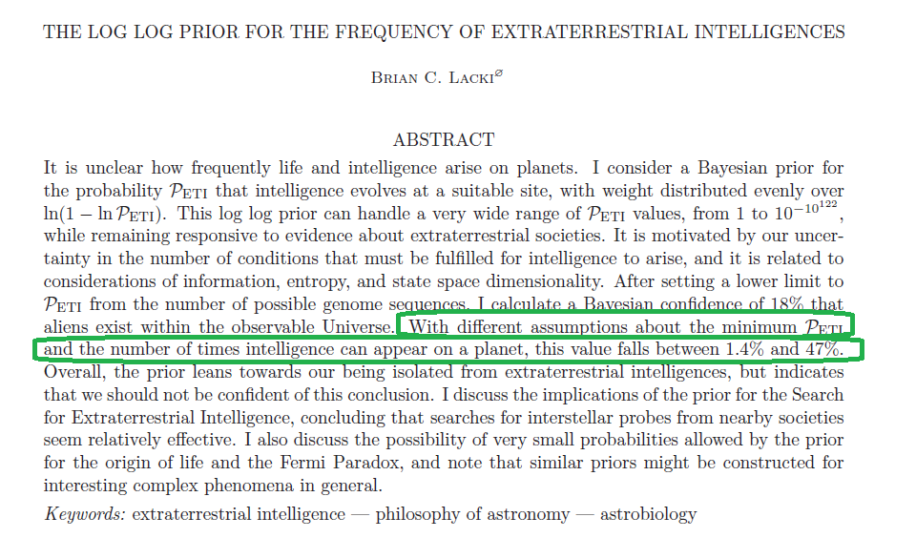
With Lack of Observations, Theorists Bloom
(Simplified) idea:
A dice with N sides
Thrown k times already
Assumption: ln(1-ln(p_{success})) is approximately flat function of unknown parameters
=> estimate the lower bound for probability of having had at least one success already from binomial distribution
In our case:
N ≈ 10^(10¹²²) (the number of quantum states of the Universe)
k ≈ 10^(4.3*10¹¹⁹) (the number of quantum states that have already materialized)
P_{success} != 0 (we exist!)
P_{Isolated} ≈ ln(1+ln(k))/ln(1-ln(1/N)) => P_{NotIsolated} ≈ 1.4 %
Similar estimates are possible using the total number of possible organic molecules or genome sequences
Ногами не бейте, допущение разумное но фиг проверишь за что купил за то и продаю!

Slide 10
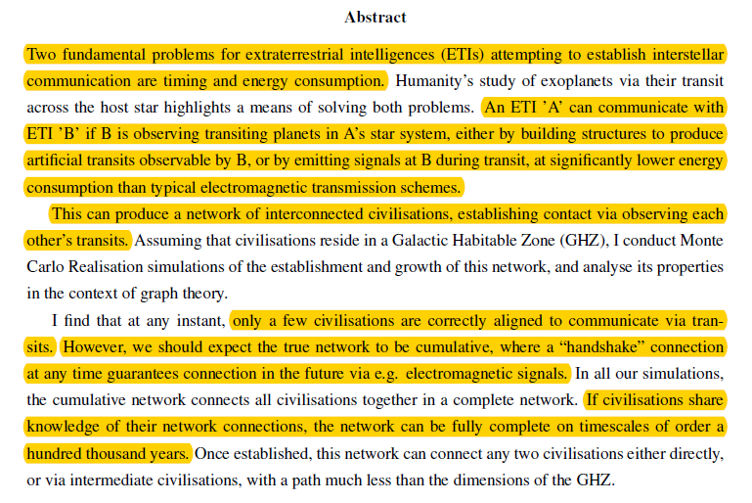
Великое Кольцо

Slide 11
Communication at Transit
Predictable direction
Predictable planet existence
Predictable moment
Requires much less power
May be solar light modulation
<После массы оптимистичных допущений у автора там вообще Великое Кольцо получается за ~100 тыс лет>
Questionable conclusion, but rather solid idea

Slide 12
Exoplanets

Slide 13
Пятый элемент метод
Five primary methods of exoplanet discovery as of 2017:
Transit: 2900
Radial Velocity: 669
Microlensing: 54
Direct Imaging: 44
Σ other: 39
[per https://exoplanetarchive.ipac.caltech.edu/docs/counts_detail.html ]

Slide 14
Пятый элемент метод

Slide 15
White Dwarf
Remnant of main of low-mass star
Made of electron degenerate matter
Density 10⁵-10⁶ g/cm³
T_{surface} = 5,000-20,000 K
Credit: http://www.astronomy.ohio-state.edu/~pogge/Ast162/Unit3/extreme.html

Slide 16
Why is it cool?
White dwarfs, it seems, do have planets – or the remnants thereof.
Those do fall into dwarf’s atmospheres – and thus reveal themselves spectroscopically.
This lets one discover new planets – and study their chemistry.
The method, “…came literally out of the blue -- absolutely no one thought of it until after it was already observationally successful. …”
“The first observational evidence of the existence of an extrasolar planetary system around a white dwarf, and indeed around any star other than the Sun, occurred 100 years ago <…> But the proper interpretation of van Maanen’s spectroscopic data -- that we now know indicate the existence of a planetary system surrounding this white dwarf <…> -- came only 90 or so years later…”
Credit: Mark A. Garlick / space-art.co.uk

Slide 17
Some Results
GD 362: a white dwarf with 17 identified elements
To date, the king of the polluted white dwarfs is GD 362 with 15 heavy elements plus H and He <…>. These elements include strontium (Sr) and scandium (Sc) that, in the Sun, are down in abundance by a factor of a billion compared to the dominant element hydrogen.
GD 61: evidence for a wet planetesimal
<> according to the analysis by Farihi et al (2013), the accreted planetesimal is especially rich in oxygen. The excess oxygen can be accounted for if the parent body was originally composed of 26% water by mass.
NLTT 43806: evidence for an extrasolar planetary lithosphere?
<…> Zuckerman et al (2011) found that the body accreted onto NLTT 43806 was aluminum and calcium-rich, and iron-poor. They compared the relative abundances of Al and eight other heavy elements seen in NLTT 43806 with the elemental composition of bulk Earth, with simulated extrasolar rocky planets, with solar system meteorites, with the atmospheric compositions of other polluted white dwarfs, and with the outer layers of the Moon and Earth. The best agreement was found with a model that involves accretion of a mixture of terrestrial crust and upper mantle material onto NLTT 43806.
WD 1145+017: observations of an asteroid being torn apart in real time
Vanderberg et al (2015) noted dips in the optical brightness of the white dwarf with periods ranging from 4.5 to 4.9 hours. They attributed these dips to the passage between Earth and the star of several chunks of material from a broken-up planetesimal. Independently, Xu et al (2016) identified 11 heavy elements in absorption either in the photosphere or a gaseous orbiting disk or both. The gaseous material has the wide velocity dispersion of ~300 km/s that is difficult to explain with any simple kinematic model. Both the broadband and the spectral line absorptions change noticeably with time
SDSS J1043+0855: evidence for a differentiated, rocky, carbonate-containing body?
Melis & Dufour (2017) describe material accreted onto this white dwarf as rocky and iron-poor, but containing substantial quantities of carbon. They consider the accreted material to come from the outer layers of a differentiated object similar perhaps to NLTT 43806 <…>, but noting that, for SDSS J1043+0855, the carbon might indicate the presence of calcium carbonates in the accreted parent body.

Slide 18
Planets Beyond Our Galaxy

Slide 19
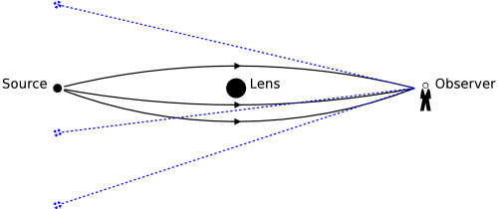
Gravitational Lens? Microlensing?

Slide 20
Planets Beyond Our Galaxy
2000 free-floating planets per main sequence star!

Slide 21
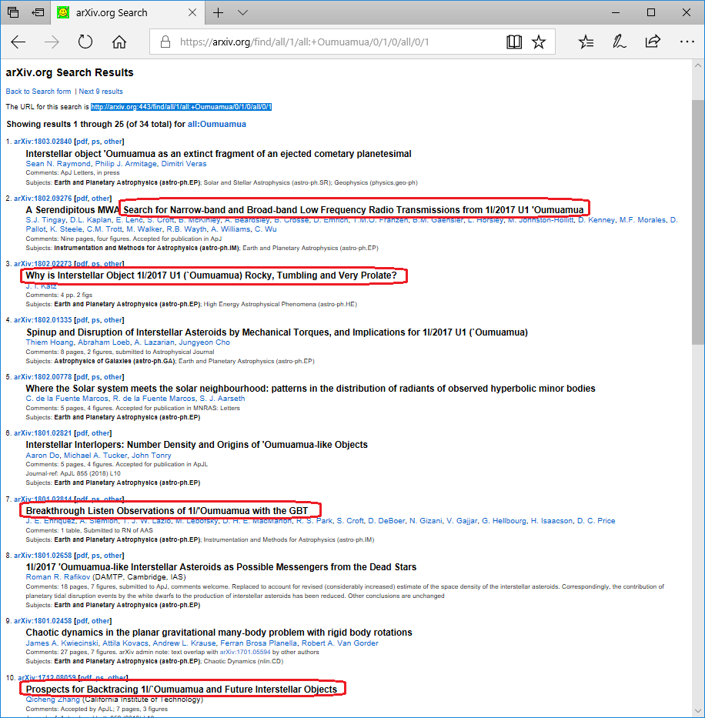
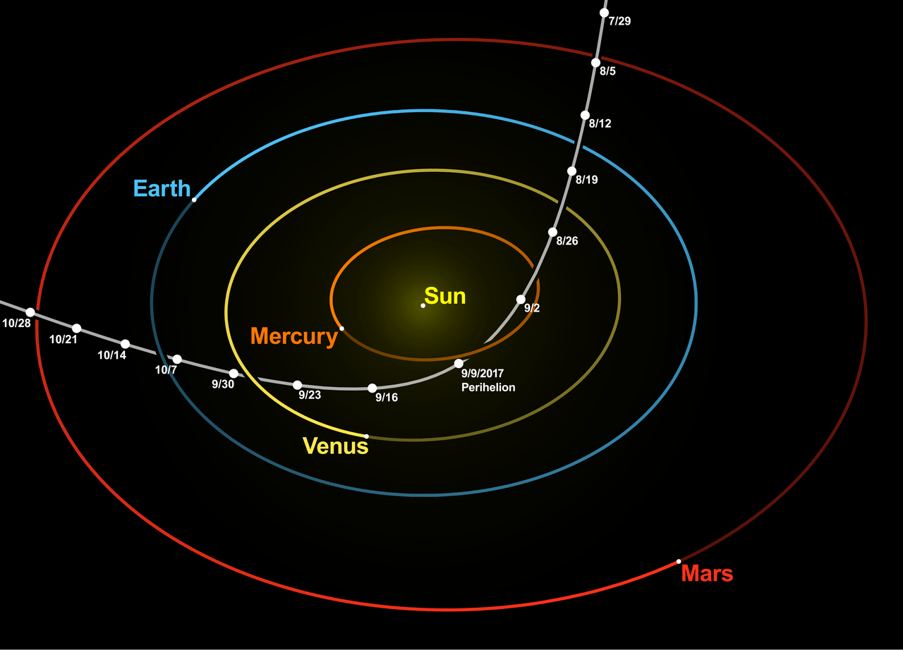
Oumauma, the Interstellar Asteroid
Unprecedented spike of publications!
http://arxiv.org:443/find/all/1/all:+Oumuamua/0/1/0/all/0/1

Slide 22
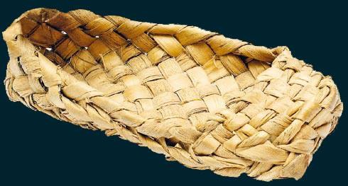
Oumauma, the Interstellar Asteroid
Average interstellar orbital speed 26.33±0.01 km/s
Dimensions 230 × 35 × 35 m ±
Rotation: Tumbling (chaotic)
https://www.youtube.com/watch?v=L2o9eBl_Gzw
No cometary activity
No radio signals detected amidst (at least) two searches
Featureless spectra, no visible ice
Reddish in color, likely dark
Probably (?) rocky and darkened by space radiation
At least 600M years old
Appeared from direction of Lyra (≈ from Vega)
Per https://arxiv.org/abs/1711.06618, “the most probable candidate for the 'Oumuamua parent stellar habitat is the star UCAC4 535-065571” (within 60 pc)
Possibly part of a planetary body broken apart by tidal forces
We may will see more – our detection capabilities grew to the right point only recently
Artist concept by ESO/M. Kornmesser

Slide 23
Intergalactic Meteor?
Very serious doubts within scientific community:
Methodology errors
Instrumental effects ignored
Questionable interpretations
Notes:
Critical reviews: http://static.astronomija.org.rs/ovogmeseca/vesti/2008/januar/medjuglaksijisi_meteoroidi2.htm

Slide 24
Part 2. Our Solar System

Slide 25
Удивительное рядом, и нам оно разрешено

Slide 26
Planetary Dust and Human Lungs

Slide 27
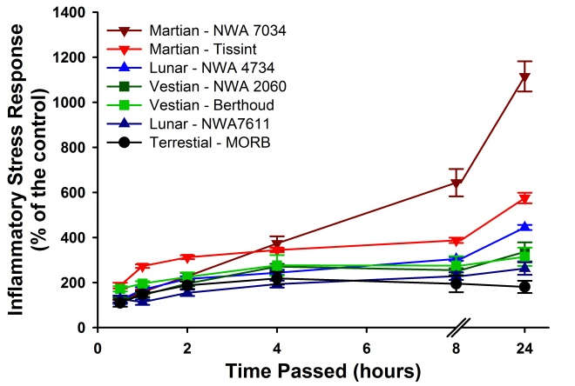
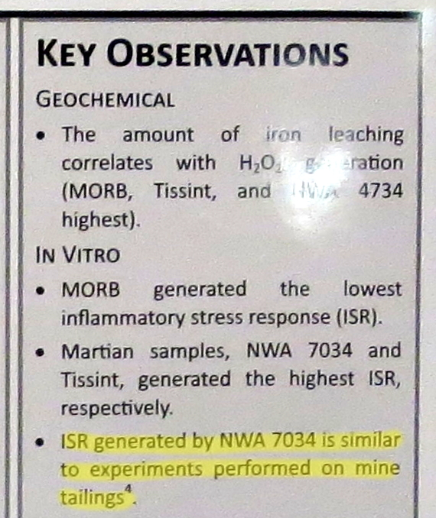
Planetary Dust and Human Lungs
Mine tailings == рудные шламы => silicosis
The ISR generated over time by the meteorite and
terrestrial dust samples at a dose of 0.002 m2/mL. For some data
points, the error bars (SEM) are obscured by the symbols.

Slide 28
Lunar Dust is Also Toxic. Why?
Per https://arxiv.org/abs/1206.6328
Small inert particles (same as asbestos or silica, known)
Free radical release
Contamination by metals
Known to cause silicosis in rats
See also https://www.ncbi.nlm.nih.gov/pmc/articles/PMC4666512/

Slide 29
Not Only Lungs Are Affected
https://ntrs.nasa.gov/archive/nasa/casi.ntrs.nasa.gov/20070021819.pdf
Reads as hardcore sci-fi. No formulas. Highly recommended.

Slide 30
Coating, Contamination & Clogging
Dust was found to quickly and effectively coat all surfaces it came into contact with, including boots, gloves, suit legs and hand tools. Consequences included the Apollo 11 astronauts repeatedly tripping over the dust covered TV cable, and a contrast chart on Apollo 12 becoming unusable after being dropped in the dust.
There were reports of equipment being clogged and mechanisms jammed in every Apollo mission. These included the equipment conveyor, lock buttons, camera equipment, and even the vacuum cleaner designed to clean off the dust.
Dust made Velcro® fasteners inoperable, and was a particular problem with some LRV indicator mechanisms. The dust also clogged EMS mechanisms including zippers, wrist and hose locks, faceplates, and sunshades. <>
The most alarming characteristic was how quickly and irreversibly this could happen. One short ride on the LRV with a missing fender extension, or standing where the equipment conveyor dumped dust on the EMS and difficulties began immediately. <>
Several [astronauts] remarked that they could not have sustained surface activity much longer or clogged joints would have frozen up completely.

Slide 31
Abrasion That Kills All Moving Parts
Lunar dust also proved to be particularly abrasive.
Pete Conrad noted that the suits were more worn after 8 hr of surface activity that their training suits were after 100 hr and further reported that their EMS were worn through the outer layer and into the Mylar® multi-layer insulation above the boot. One or two additional EVAs could have resulted in a pressure failure in the Apollo 12 EMS.
Gauge dials were so scratched up during the Apollo 16 mission as to be unreadable.
<> the cover gloves worn by the Apollo 17 astronauts when they were working the core drill were so worn through after drilling core samples after only two EVAs that they were removed and discarded at the beginning of the third.
No hammer handle picture ☹

Slide 32
Thermal Control Problems
An insulating layer of dust on radiator surfaces could not be removed and caused serious thermal control problems.
<> on Apollo 16 and 17 the LRV batteries exceeded operational temperature limits because of dust accumulation and the inability to effectively brush off the dust.
John Young remarked that he regretted the amount of time spent during Apollo 16 trying to brush the dust off the batteries — an effort that was largely ineffective. (This was contrary to ground-based tests which indicated that dusting the radiator surfaces would be highly effective.)
This led him to recently remark that “Dust is the number one concern in returning to the moon.”

Slide 33
Seal Failures
The ability of the EMS to be resealed after EVA was also compromised by dust on the suit seals.
Pete Conrad’s suit, which was tight before the first EVA, developed a leak rate of 0.15 psi/min after it, and rose to 0.25 psi/min after the second EVA. Since the safety limit was set at 0.30 psi/min, it is doubtful whether a third EVA could have been performed, had it been scheduled.
Another indicator is that all of the environmental sample and gas sample seals failed because of dust. By the time they reached earth the samples were so contaminated as to be worthless.
This does not bode well for a long duration habitat where several astronauts will be passing through air locks and unsealing and resealing their EMS routinely. More attention must be directed at ways either to keep dust off the seals, or to make more dust tolerant seals.

Slide 34
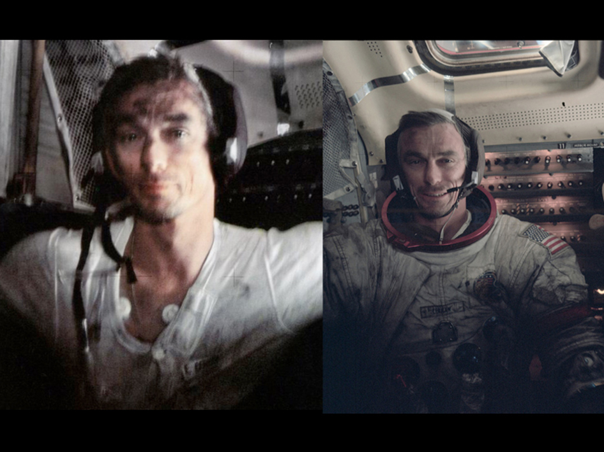
In Gene Cernan’s Words:
“Dust - I think probably one of the most aggravating, restricting facets of lunar surface exploration is the dust and its adherence to everything no matter what kind of material, whether it be skin, suit material, metal, no matter what it be and it's restrictive friction-like action to everything it gets on.
<> By the middle or end of the third EVA, simple things like bag locks and the lock which held the pallet on the Rover began not only to malfunction but to not function at all. They effectively froze.
We tried to dust them and bang the dust off and clean them, and there was just no way.
Once you get inside the spacecraft, as much as you dust yourself, you start taking off the suits and you have dust on your hands and your face and you're walking in it. You can be as careful in cleaning up as you want to, but it just sort of inhabits every nook and cranny in the spacecraft and every pore in your skin.”

Slide 35
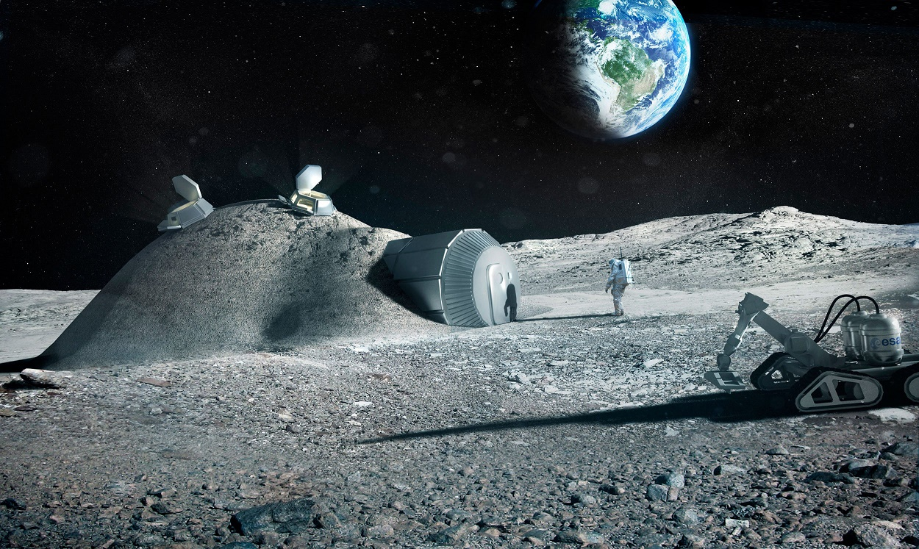
Multi-year Lunar Base Looks Rather Questionable
Image Credit: European Space Agency

Slide 36
Lunar Swirls

Slide 37
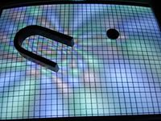
Lunar Swirls (“Лунные диффузные структуры”)
Are there permanent magnets underneath them, protecting the surface from solar wind?

Slide 38
Beyond The Moon

Slide 39
Rings beyond the giant planets by Bruno Sicardy, Maryame El Moutamid, Alice C. Quillen, Paul M. Schenk, Mark R. Showalter and Kevin Walsh
Chariklo
The largest body between Saturn and Uranus
296 x 264 x 204 km
Very dark – albedo ~4%
Two rings several km width, separated by 8.7 km gap

Slide 40
Rings beyond the giant planets?
Iapetus ridge, too?

Slide 41
PENITENTES AT TARTARUS DORSA, PLUTO

Slide 42
“Penitentes?”
Дык, кальгаспоры

Slide 43
Penitentes AKA Кальгаспоры
Complex formation made by play of illumination and ice evaporation

Slide 44
PENITENTES AT TARTARUS DORSA, PLUTO
Observational evidence and theoretical considerations suggest this land is filled with penitents made of frozen Nitrogen.

Slide 45
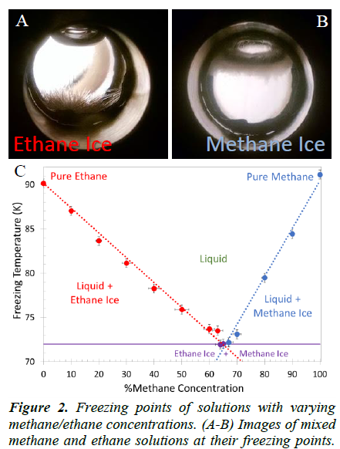
METHANE, ETHANE AND NITROGEN LIQUID STABILITY ON TITAN Hanley1, L. Pearce2,3, G. Thompson2, W. Grundy1, H. Roe1, G. Lindberg2, S. Dustrud2, D. Trilling2, S. Tegler2. 1Lowell Observatory, Flagstaff, AZ (jhanley@lowell.edu), 2Northern Arizona University, Flagstaff, AZ, 3University of Texas, Austin, TX.
-180 C
CH₄
C₂H₆
N₂

Slide 46
METHANE, ETHANE AND NITROGEN LIQUID STABILITY ON TITAN
Now add Nitrogen…
Съемка скрытой камерой
Нефтяная индустрия?

Slide 47
The End
Questions? Speeches? Toasts?

Slide 48
Backuppendix

Slide 49
Великое Кольцо

Slide 50
Почему не в звезде?

Slide 51
Lunar Dust Sticks – Even in Ground Tests
Preliminary testing was done to remove the dust by nitrogen jet, which proved almost totally ineffective with small particle sizes. Fine dust (<34 μm) with an initial dust coverage of 4.5 percent had an initial absorptance of 0.245. After blowing on the sample for 15 sec with 10 psi nitrogen, the absorptance was only reduced by 2 percent to 0.239.
Use of an imcompressible fluid (water, benzene, or tricloroethane) did not improve the results much.
The results of vibration tests were even worse. Vibration was most effective when the sample was tilted and the vibration was at the resonant frequency, but the fine particles were not substantially removed.
Three different brush tests were also carried out, one with a bristle brush, one with Styrofoam®, and one with cheese cloth. Of these, the Styrofoam brush was the most effective.

